Slide 1

Chapter 1
Introduction
Phoenix.gov

Slide 2
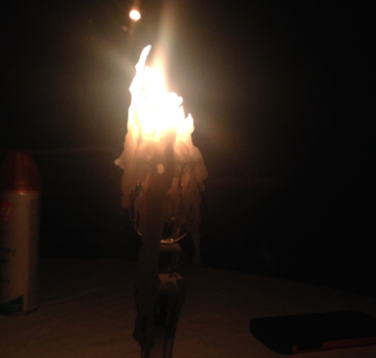
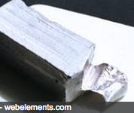
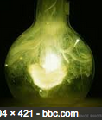

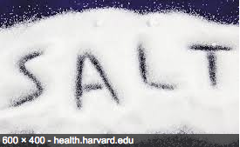
Chemistry!
The science that studies the properties of substances & how substances react with one another.
How stuff works on a molecular/atomic/subatomic level
MATTER
ENERGY
REACTIONS
Has mass & takes up space
The capacity to do work or cause change
How materials interact & change

Slide 3
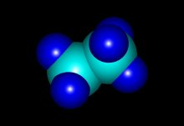
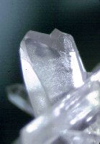
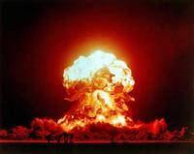
Learning the Language
Chemistry describes materials and predicts
behavior using three basic concepts
Composition
    •Mass percent of elements/compounds
    present
    •Atomic/molecular ratios within material
    •Stoichiometry
  Structure
    •Molecular/ionic/atomic arrangement
    •Phase (solid, liquid, gas)
  Properties – chemical & physical
    •Specific to a particular material
    •ex: boiling point, color, odor, reactivity
    •Used for identification

Slide 4
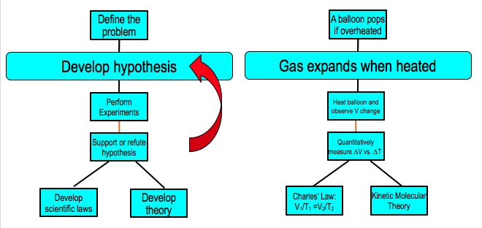
The Scientific Method
Series of steps that explain an observation
Molecules move faster when heated requiring more space, causing balloon to pop.

Slide 5
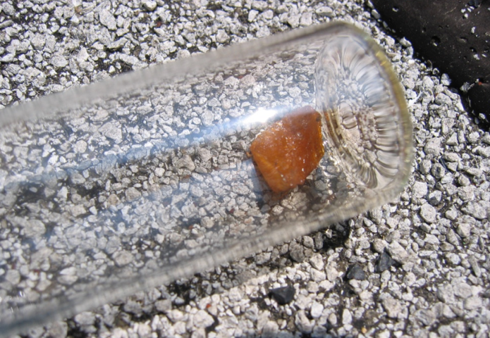
Classifications of Matter
What is in the material you are investigating? 𝛌
?
?

Slide 6







Pure materials
Atom:
•Smallest distinctive unit w/ properties of element
Molecule:
•2 or more atoms together
Pure Substance:
•Definite/constant composition & distinct properties
•TWO types of pure substances:
- Element → one type of atom
- Compound→ more than one type
of atom chemically bonded
• Compounds contain more than
one element – still a pure substance!!!

Slide 7
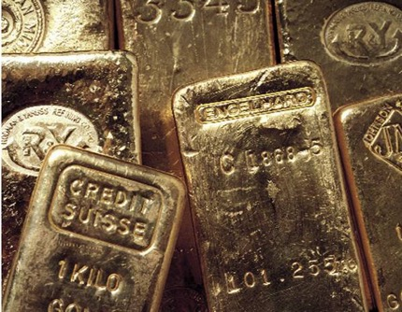
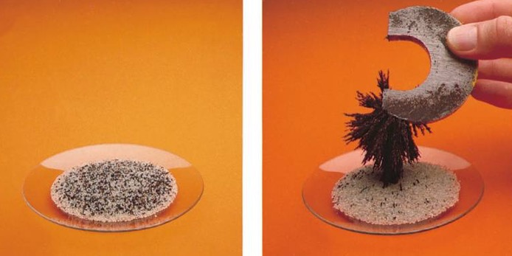
Mixtures
Mixture: Combination of 2 or more pure substances
•Can be separated by physical means
Homogeneous Mixture
•Substances stay mixed
•No distinct layers
•Uniform properties
•Also called a “solution”
14 karat gold
Mixture of gold and silver
Heterogeneous Mixture •Substances separate easily
•Distinct layers often seen
•Properties may not be
uniform
Iron filings and sand

Slide 8
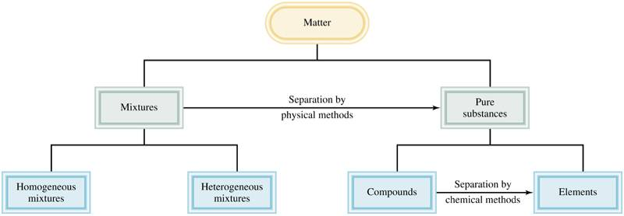
Matter Summary

Slide 9
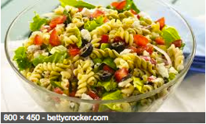
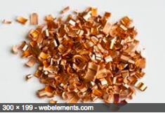
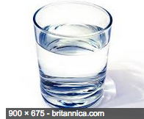
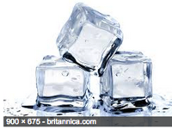
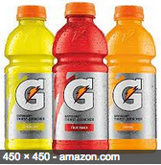
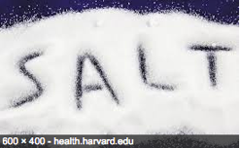
Heterogeneous mixture
Homogeneous mixture
Pure Substance

Slide 10
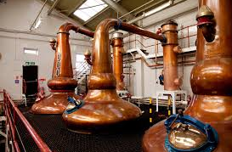
Physical and Chemical Properties of Matter
Can be used to identify & separate substances
port-magazine.com

Slide 11



Physical Properties of Matter
Can be changed without changing
molecular composition
Chemical identity is NOT CHANGED
    eg: smashing a window – still glass
    melting ice – still water
Phase changes are physical changes
(solid to liquid to gas etc.)
Melting, freezing, boiling, etc.
Can be used to ID a substance without damage
Color, odor, solubility, conductivity, density
  molecular mass, boiling/melting points
Original compound can be recovered
  CHEMICAL BONDS ARE NOT BROKEN DURING PHASE CHANGES!

Slide 12
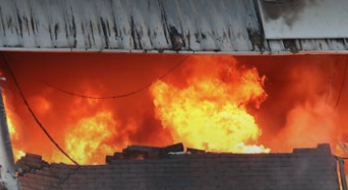

Chemical Properties of Matter
Describe how chemicals react with each other
  What will they react with?
  How will they react?
  • Generate heat or light?
  • Burn? Explode?
  • Decompose slowly? (Rusting, rotting)
Compositional changes to molecules
  • Often called a chemical change
  • Original material changed on an
  atomic level
Original compound no longer present
• Compound cannot be restored to its original
form without another chemical change
Ready.gov

Slide 13
Extensive and Intensive Properties
Extensive Property: Depends on amount of matter present
ex: mass, length, volume, heat,
intensity of color or odor
Intensive Property: Independent of amount of matter present
ex: Temperature, boiling point, color, odor
Often a calculated ratio
ex: Density (mass/vol ratio)
Molar mass (grams/mol)
Specific heat (J/g)
Intensive properties can be used to identify a material, extensive properties cannot. Why?

Slide 14
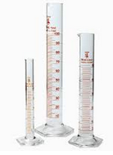
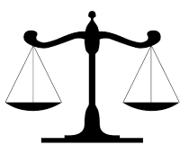
Measurements
Determining how much matter is present
olin.edu
amazon.com

Slide 15
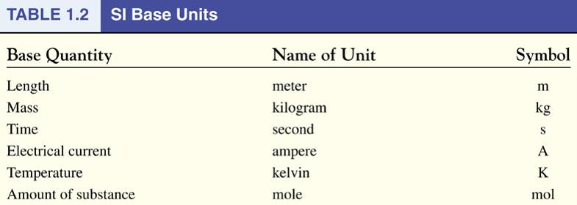
Base Units of Measurement
International System of Units (SI)
Will be used frequently in CHM 10; you are expected to know them! (Depending on other classes, will likely need to know ampere in the future.)

Slide 16
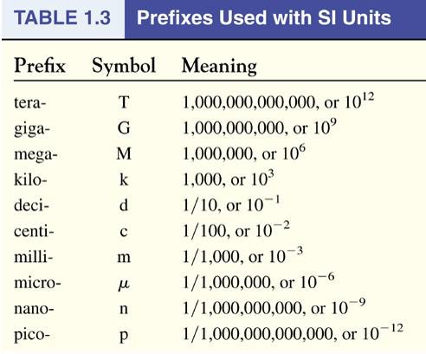
SI Prefixes
Yes, you need to know these too
hecto (10²)
deca (10¹)
Base
The Great Majestic King Henry Died By Drinking Chocolate Milk at Mad Nick’s Palace

Slide 17
The Great Majestic King Henry Died By Drinking Chocolate Milk at Mad Nick’s Palace
tera
(10¹²)
giga
(10⁹)
Mega
(10⁶)
kilo
(10³)
hecto
(10²)
deca
(10)
base
(1)
deci
(10⁻¹)
centi
(10⁻²)
milli
(10⁻³)
micro
(10⁻⁶)
nano
(10⁻⁹)
pico
(10-¹²)
25 m = 0.000000000025 Tm
25 m = 0.000000025 Gm
25 m = 0.000025 Mm
25 m = 0.025 km
25 m = 0.25 hm
25 m = 2.5 dam
25 m = 25 m
25 m = 250 dm
25 m = 2500 cm
25 m = 25000 mm
25 m = 25,000,000 μm
25 m = 25,000,000,000 nm
25 m = 25,000,000,000,000 pm
25 Tm = 25,000,000,000,000 m
25 Gm = 25,000,000,000 m
25 Mm = 25,000,000 m
25 km = 25,000 m
25 hm = 2500 m
25 dam = 250 m
25 m = 25 m
25 dm = 2.5 m
25 cm = 0.25 m
25 mm = 0.025 m
25 μm = 0.000025 m
25 nm = 0.000000025 m
25 pm = 0.000000000025m

Slide 18
Metric Conversion Examples
1.) Convert 256.74g to kg
(0.25674 kg)
2.) How many milliliters are in 3.78 L?
(3780 mL)
3.) Convert 18000000 cm into Mm
(0.18 Mm)

Slide 19
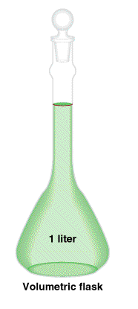
Derived Units: Volume
SI derived unit for volume is a cubic meter (m³)
Common unit is a “Liter (L)”
1 L ≠ 1 m³
1L = 1x10⁻³m³
1cm
1cm
1 mL = 1 cm³
1cm

Slide 20
Metric Conversions with Units that are squared (s²), cubed (cm³), etc. can be tricky:
ex.) Convert 87856 cm³ to m³
Note: 1 m = 100 cm but 1m³ ≠ 100 cm³
Need to do the conversion 3x for cubed numbers
(2x for squared, etc.)
87856 cm³ = 0.087856 m³

Slide 21
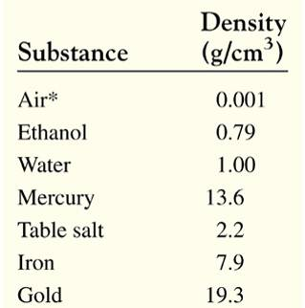
Derived Units: Density
Density: Ratio of mass to volume of a material
mass
m
density =
=
volume
V
SI derived unit for density is kg/m³
1 g/cm³ = 1 g/mL = 1000 kg/m³
Intensive property
• Can be used to identify a material
• Units of mass and volume may vary

Slide 22
Handling Numbers
Math Review
😱

Slide 23
Scientific Notation
For very large or very small numbers
Significant digits
1.7 x 10⁶
Size of number
(multiplier)
Positive exp = large number (>1)
1700000 → 1.7 x 10⁶
0.0000017 → 1.7 x 10⁻⁶
Negative exp = small number (<1)
Rules:
Keep all significant numbers
Place decimal after 1st significant number (1.7)
To get exponent:
  Count number of places decimal moved to get to correct location (after 1st significant number). This value is your exponent.
  If the number is >1, exp is positive 1700000→ 1.7 x 10⁶
  If the number is <1 exp is negative 0.0000017 → 1.7 x 10⁻⁶

Slide 24
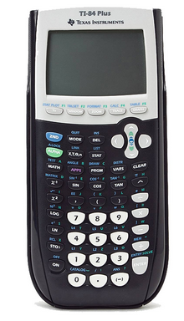
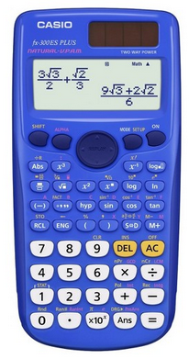
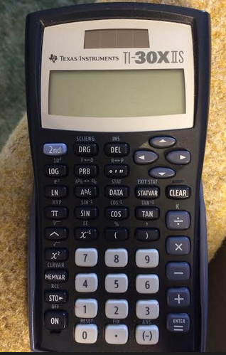
Use EXP, SCI, EE or x10^{x} keys on calculator

Slide 25
Scientific Notation Examples
Write the Following in Scientific Notation:
1.) 280000000
2.) 280.0
3.) 0.000000004577
4.) 0.00000060
Write the Following in Standard Format:
1.) 2.45 x 10²
2.) 3.98 x 10⁶
3.) 4.29 x 10⁻³
4.) 8.0 x 10⁻⁶

Slide 26
Significant Figures:
Number of Digits to Report in Final Answer
1. All non-zero digits are significant
2. Use decimal point to decide if zeros are significant
Between 2 numbers significant 50.002 5 sig figs
Before decimal point not significant 0.502 3 sig figs
Before the first digit not significant 0.0052 2 sig figs
End of # after decimal significant 0.0200 3 sig figs
No decimal point: not significant 500 1 sig fig
3. Exact numbers have unlimited number of sig. figs.
Inherently an integer: e.g. 4 sides to a square
Inherently a fraction: e.g. ½ of a pie
Obtained by counting: e.g. 47 people in a class
Defined quantity: e.g. 12 eggs in a dozen

Slide 27
Determining the correct number of significant figures (sigfigs) in math problems:
Answer is based on the LEAST significant value
Addition/subtraction – Sig figs based on decimal
1500
+ 2976
4476
12.45XX
- 9.2680
3.1820
4500
3.18
Multiplication/Division – Sig figs based on all sig digits
4 sig figs
3 < 4 so 3 sig figs
3.182 x 3.57 = 11.35974
11.4
3 sig figs
Rounding is based on number after last sigfig:
≥ 5 round up ≤ 5 round down

Slide 28
Multiple math functions – follow order of ops
(12.45 - 9.2680) x 3.575 = 11.37565
Step one: Subtraction → Sigfigs based on decimal
(12.45 - 9.2680 ) = 3.182
2 sigfigs after decimal
3 sigfigs overall in final answer
Step two: Multiplication → Sigfigs based on all sig digits
3.182 x 3.575 = 11.37565
3 sigfigs in 1st number, 4 in 2nd → 3 in final answer
Here addition limits sigfigs
Round up because the next number is >5
11.37565 → 11.4
12.45XX
- 9.2680
3.1820

Slide 29


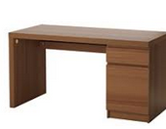

Why do significant figures matter?
123.52 cm
121 cm
Width of room: 244.6 cm
Will the two desks fit?
123.52 cm
+ 121.?? cm
244.52 cm
245 cm
Fitting desks in a room may not seem all that important – but the same concept is true for the design of buildings & bridges!

Slide 30
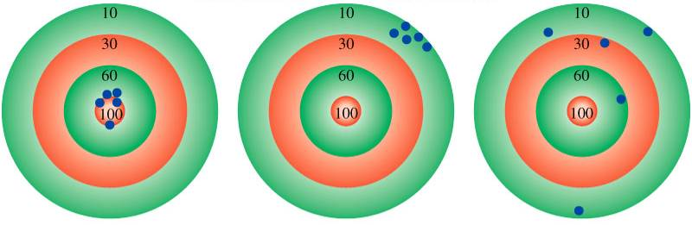
Precision and Accuracy
Accuracy – how close a measurement is to the true value
Precision – how close measurements are to each other
accurate
&
precise
precise
but
not accurate
not accurate
&
not precise

Slide 31
Percent Error
Comparison of experimental results to
expected or real values
• Usually reported without a + or - sign
% error = ⎪Experimental value - Real value⎪ x 100
Real value
Experimental value - Real value = Deviation
• Often reported with a + or – sign
Real value:
• Widely accepted, often an industry standard value
• Average of several experiments can sometimes be used if real value is unknown

Slide 32
Dimensional Analysis
Algebra and canceling units
Look at question:
How many kilograms of methanol will fill a 15.5 gallon fuel tank of a car modified to run on methanol? (Density of methanol = 0.791 g/mL)
What unit do you want to solve for?
What information do you need?
Data in problem:
Data to look up:
Data to know:

Slide 33
Dimensional Analysis Problems
1) How many kilograms of methanol will fill a 15.5 gallon fuel tank of a car modified to run on methanol? (Density of methanol = 0.791 g/mL; 1 gal = 3.785 L) A: 46.4 kg

Slide 34
2) How many liters are equal to 500. cm³? A: 0.500 L
3) A cube with sides measuring 7.50 m has a mass of 0.04567 mg. What is the density of the cube in μg/mL? A: 1.08 x 10⁻⁷ μg/mL

