Slide 1
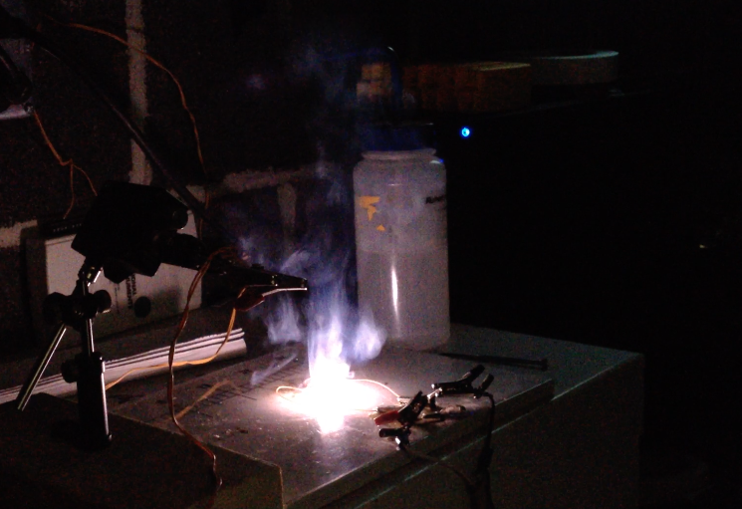
Chemistry !!!
101
Spring 2018
Dr. Maria A. Donnelly
Beaupre 117C
madon@uri.edu

Slide 2
Why Learn Chemistry?
To better understand the environment around us
Medicine
•Understanding disease
•Develop new drugs
Environmental Science
•Ozone layer
•Global warming
•Acid rain
Agriculture
•Bioengineered food
•Fertilizers
Criminal Justice & Safety
•Forensics
•Explosives
& Drug detection
  •Safety equipment
Material Science
•Better built houses
•More efficient cars
•Plastics, composites

Slide 3
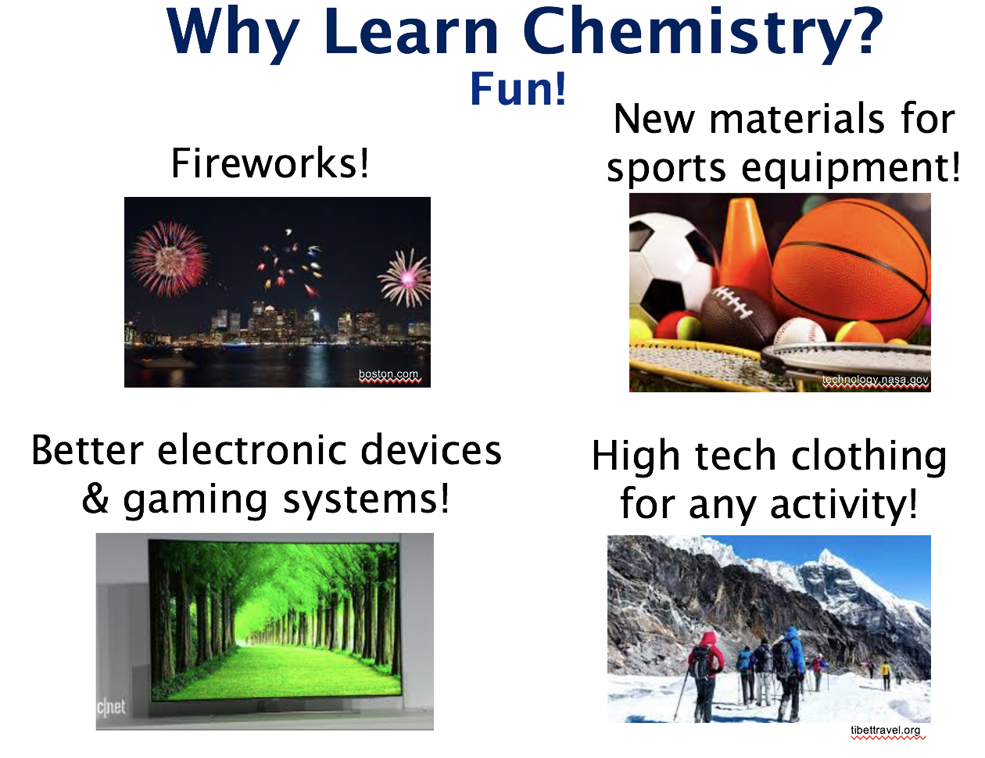

Slide 4
Expectations
CHM101 - Freshman Chem. Lecture (lab – CHM102)
  • Required if 3-4 semesters of chem. required by major
  • Pharmacy, Engineering, Biology
  • Pre-professional programs: med, dental, veterinary etc.
  • Some environmental science groups
  • Emphasis on mathematical skills (esp. algebra) & problem solving (most exams ~ 80% math)
  • Other General Chemistry courses – 103, 191
  • Grading:
  - Connect on-line homework & Learnsmart (15%)
  - Four lecture exams (68%)
  - Final exam (17%)
  - to calculate: (HW avg * 0.15) + (exam avg * 0.85)

Slide 5
Your choices will determine your level of success
  • Attendance is important
  - prepare in advance – become familiar with key terms & ideas
  - pay attention, ask me questions
  - print out slides and bring them with you to take notes on
  • Assignments are designed to help you learn
  - focus on WHY you need to follow certain steps to solve problems rather than trying to memorize the steps
  - ask yourself what you do and do not understand
  • Complete assignments on time
  - mastery of early material will help with material covered later
  - avoid having assignments build up & losing points due to
  lateness
  • Seek help right away!
  - office hours
  - TAs in Beaupre 115 Learning Center
  - AEC tutoring group or walk in tutoring

Slide 6
Be Courteous to Your Classmates
  • If you arrive late/need to leave early, use the back
  entrance
  • Your peers can be a great resource, but please wait till
  after lecture to talk with them
  • Give everyone a chance to answer
  • Remember why you are here
  - TV shows, games, movies, & social media will not help you learn
  - they are also visible to the students sitting behind you & can be
  quite distracting

Slide 7
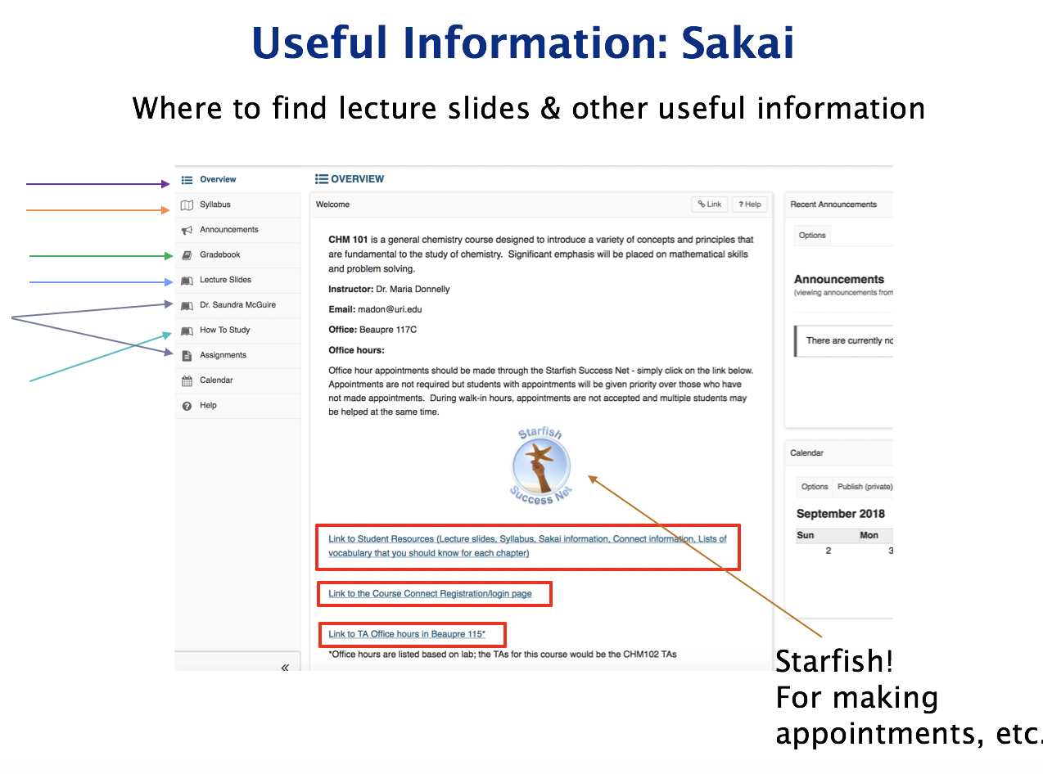

Slide 8
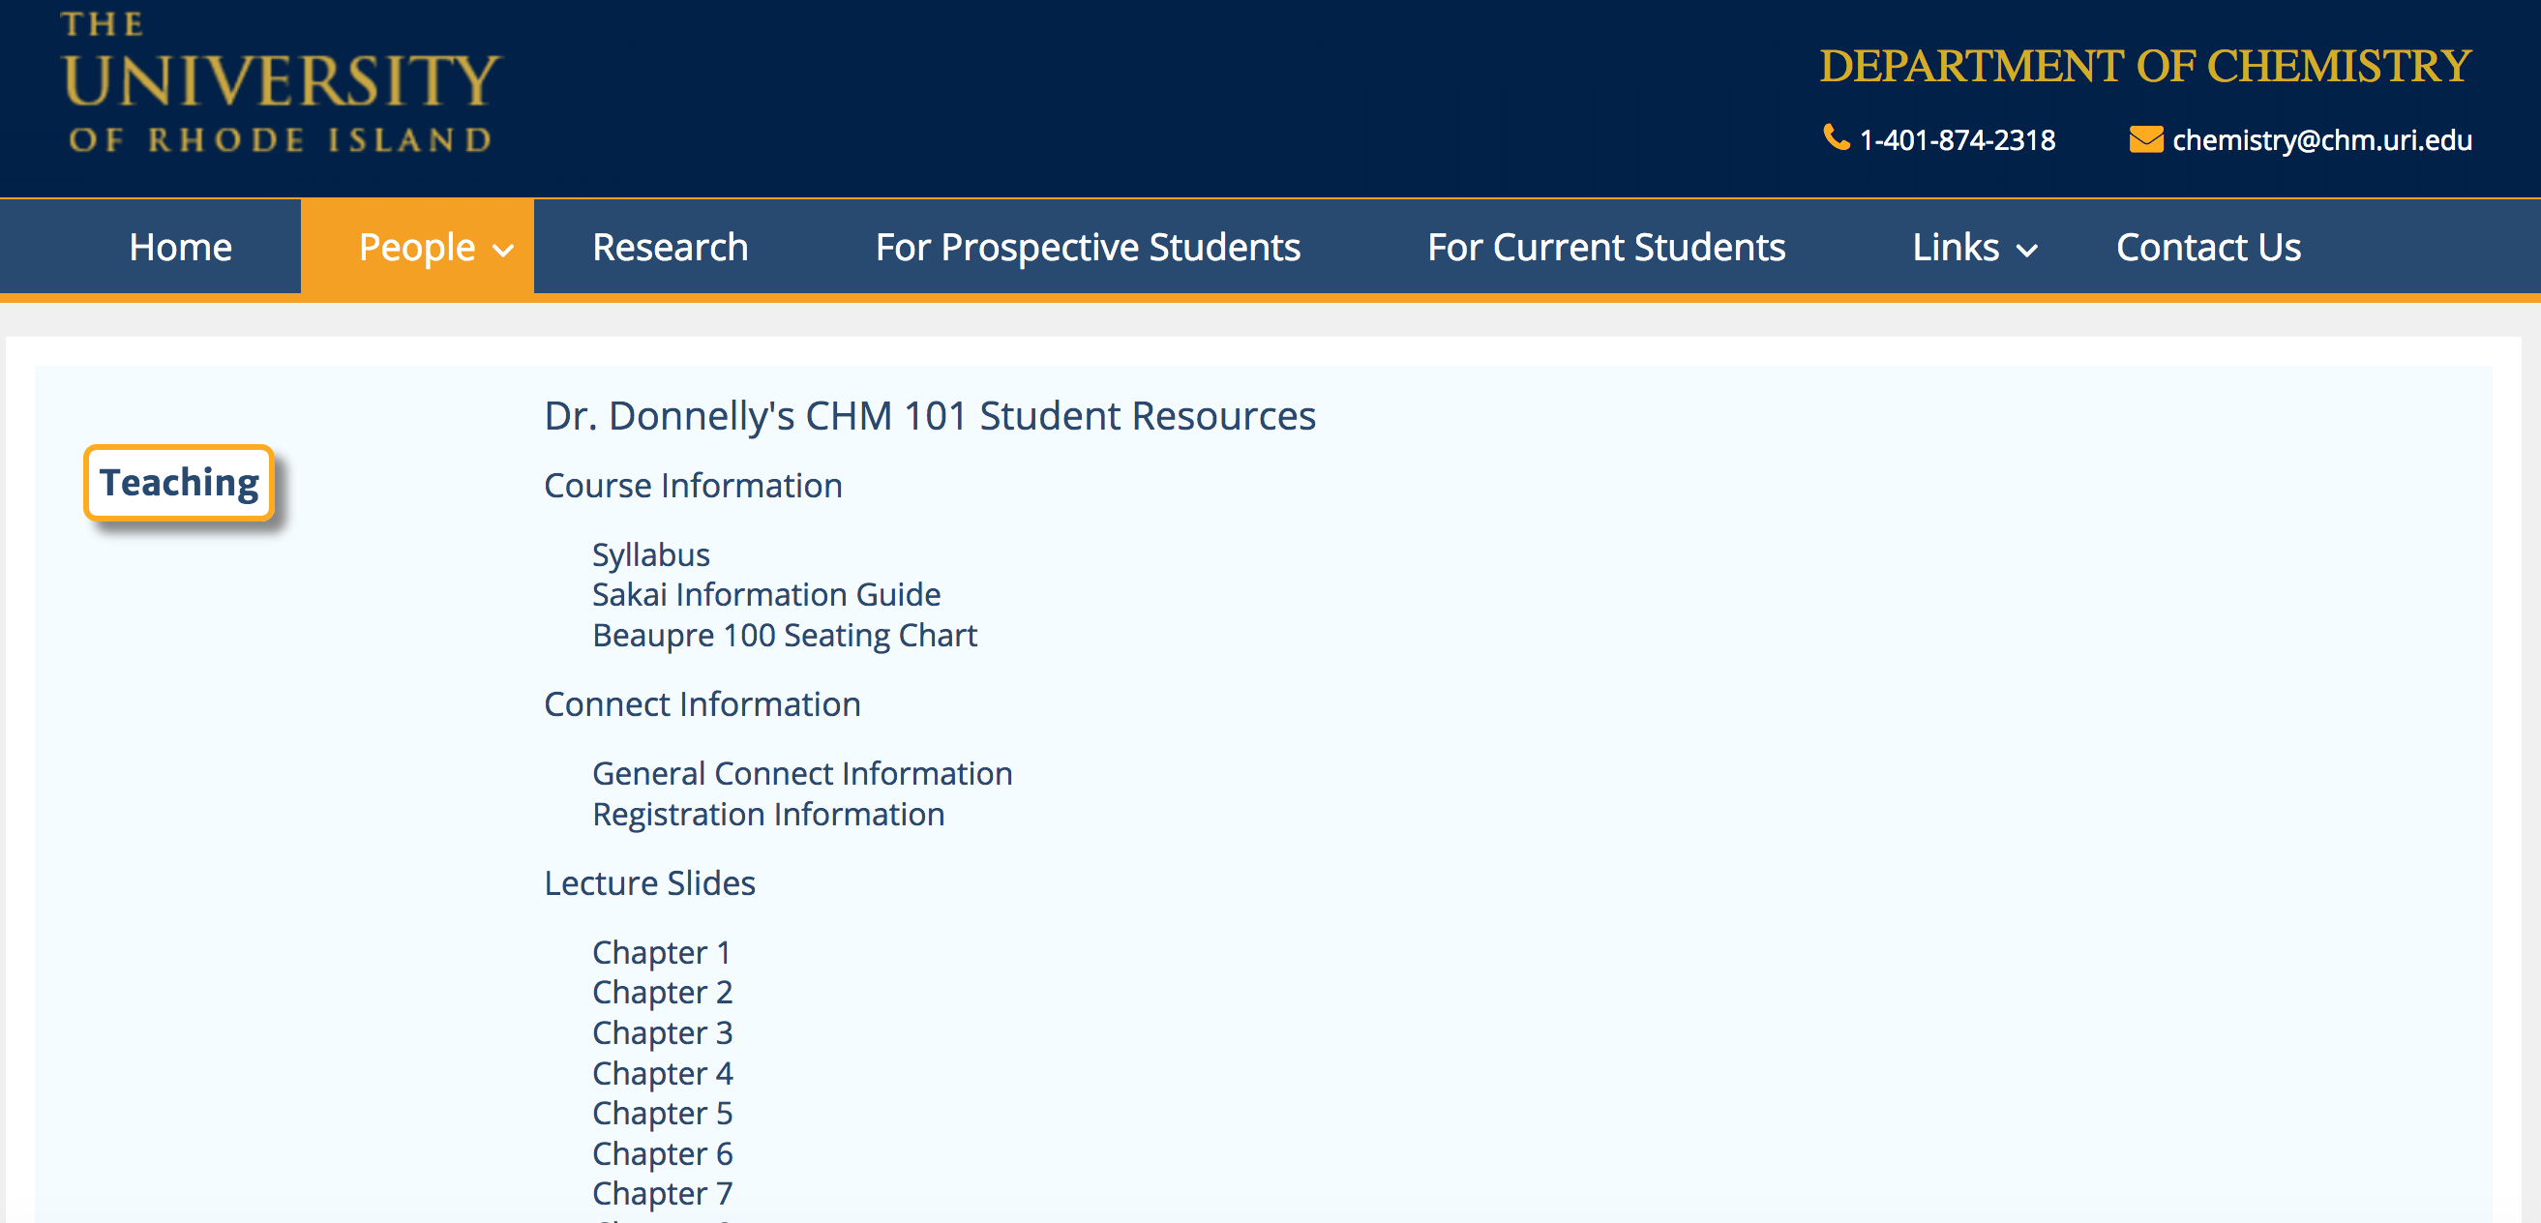
Useful Information: Lecture Notes, etc.

Slide 9
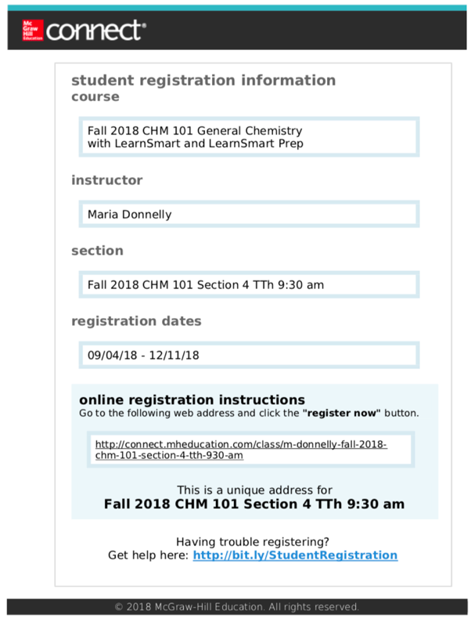
Useful Information: Connect
Registration Information
is section specific!
Your Section!
Section 1:
Spring 2018
TTh 9:30 am
Section 2:
Spring 2018
TTh 11:00 am
Section 4:
TTh 9:30 am
Link to registration page

Slide 10
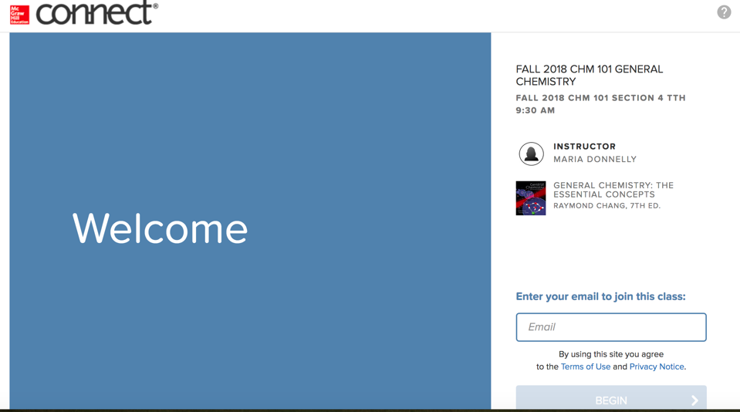
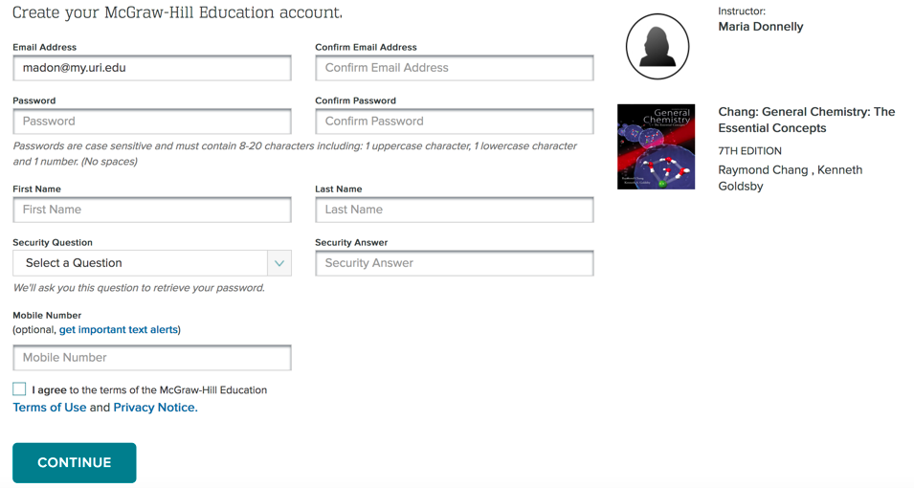
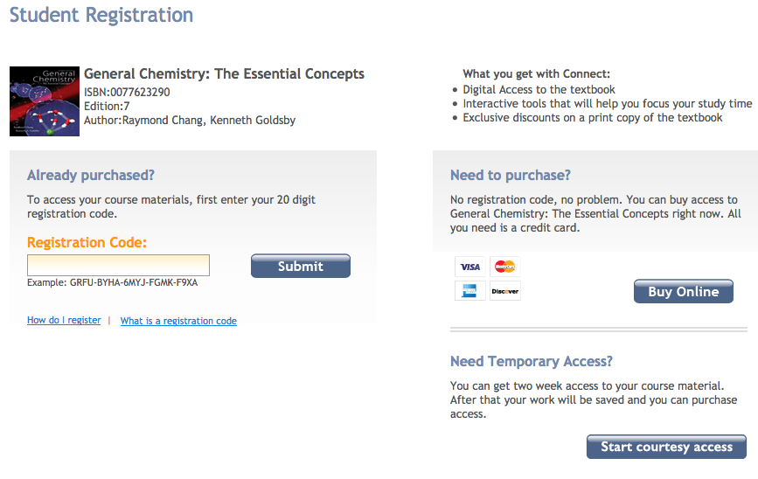
Useful Information: Connect Registration
Courtesy Access has been extended to 1 month for this semester.
(Older screenshot, may look slightly different now)

Slide 11
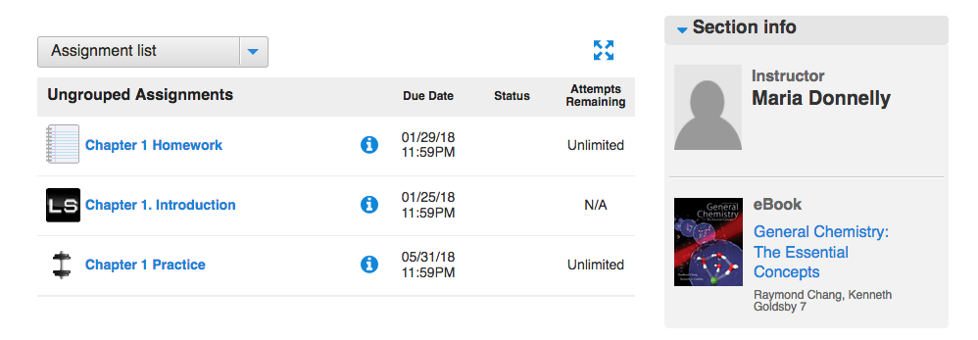
Useful Information: Connect Assignments
Required
NOT
Required
LS = Learnsmart

Slide 12
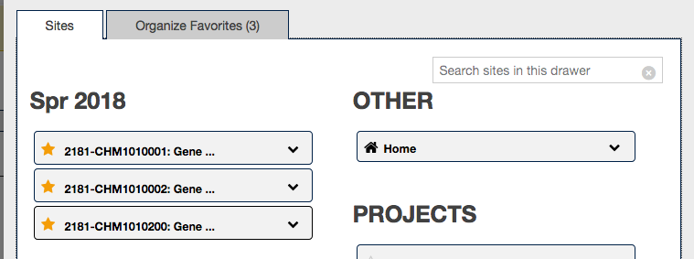
Useful Information: Sakai
Adding (or removing) courses from tabs in Sakai
Yellow stars will show up as tabs

Slide 13
Chemistry Labs Start This Week!!!
Safety Training is required for all Chem. labs and is only given during your first lab session
Anyone without safety training after the first week will be dropped from their lab section
If you miss your first lab:
Attend a makeup safety training session by Tuesday September 11th!
You must attend a safety training specific to your course (see ecampus for times)
Attend your assigned lab next week
If you want to get into a lab:
Sign up on Wait List at www.chm.uri.edu
Attend a safety training session
You will be emailed a permission number if an opening becomes available
Safety training is held during regularly scheduled labs ONLY
If you miss your lab, you must make up the safety training by Tues.

