Slide 1
Forensic Toxicology
Robert Almeida, MS, D-ABFT-FT, TC-NRCC
Supervisor, Forensic Toxicology
Rhode Island Department of Health
Notes:
Self-introduction: education, board cert

Slide 2
Overview
Introduction to FT
Impaired Driving Program
Local and National Statutes
FT DUI Testing Protocol/ Process
Analytical Instruments
Pharmacology of Drugs and Ethanol
Notes:
FT: definition and programs; types of analytical work performed and types of cases worked on
Examine FT by looking specifically at the impaired driver program.
What is drunk and drugged driving
Discuss/review local and national laws
Testing performed and interpretation

Slide 3
Forensic Toxicology
The analysis of biological specimens (ex. body fluids, tissues & organs) to determine the presence or absence of drugs and/or poisons for medico-legal purposes.
Notes:
In RI – the Health Department is mandated by statute to provide lab services for the Office of the ME and LE. 80% ME/20% LE
No testing for public/private citizens, only state agencies

Slide 4
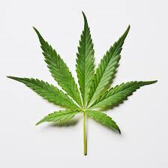
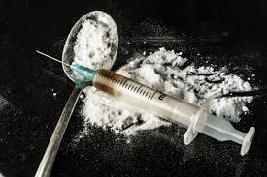
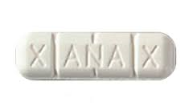
Forensic Toxicology
Did drugs and/or alcohol cause or contribute to an individual’s death or behavior?

Slide 5

Forensic Toxicology
Drugs and Poisons in Biological Samples
Three Sub-disciplines:
Post-mortem toxicology:
Autopsy specimens
Manner and cause of death
Urine drug testing:
Pre-employment or on the job drug use
Drug maintenance program
Human performance toxicology
Notes:
Post-mortem tox: analyze autopsy specimens for drugs and/or poisons
Manner: accidental, homicide, suicide, natural, undetermined
COD: the incident or act that caused the death; ex. Drowning, stabbing, OD

Slide 6
Human Performance Toxicology
“Behavioral toxicology”
How drugs influence human performance or behavior
Physically and psychologically
Legal consequences of alcohol and drug use
Law Enforcement:
Impaired-driving
Drug facilitated sexual assault
Other criminal acts while under the influence of a drug
Notes:
Physiological: movement, response to external stimuli: ex. With driving, environmental conditions (weather, roads)
Psychological: emotions, attentiveness, and decision making
MV operation is very complicated; many decisions and follow-through; messages relayed from mind to body.
Impaired driving: MV, OUI, assault and homicide/death resulting; boating and maritime investigations.
Drug-facilitated crimes: sexual, misdemeanor, ex. B & E; felony: homicide/murder

Slide 7
“Drunk” Driving
Alcohol/ Ethanol Related
Correlation between ethanol in the blood and the level of impairment
Statutes: Motor Vehicle Offenses
All fifty states
Blood Alcohol Concentrations/ set measurements:
Driving Under the Influence (DUI): 0.08%
Driving While Impaired: 0.02%
D.O.T./Federal: 0.04%
Additional/Aggravated Offenses per Statutes
Proposed legislation
Notes:
Term: ignores drugs
Blood measurement
DUI, OUI, OWI
Statutes: 2003; all 50 states; level of intoxication determined by a measurement; BAC or BAL; regardless of impairment
DUI: any person, age, national level
DWI: Underage drinking, <21, zero tolerance.
DOT: federal transportation workers, CDL (commercial drivers license); airline pilots, RR workers, truckers; effect on-duty, 4 hrs. prior, or 8 hrs. post-duty following a reportable incident.
Additional offenses: repeat offender, BAC >0.15%, child in the MV, injury or fatality resulting, drugs present.
Utah: initiated a bill to lower the BAL to 0.05%; Washington and Hawaii also considering lowering the BAC level to 0.05%; Europe: 0.05 or 0.02%
RI: highest percentage of alcohol-related MV crashes (43%)

Slide 8

“Drunk” Flying
March 2016 @ 7:00 AM
Detroit to Philadelphia
Fifty year old AA co-pilot arrested in the cockpit
Operating an aircraft while under the influence of alcohol
Legal limit: 0.04%
Breathalyzer: 0.08%
Misdemeanor
Notes:
Cannot fly under the influence or consume 4 hrs. before a flight

Slide 9
Drugged Driving Laws
All states have laws against drugged-driving
*No set measurements for DUID.
Why?
Alcohol is a simpler compound and therefore processed more easily than drugs.
No close link between blood and drug levels and measured impairment.
Interactions occur with drug-drug and drug-alcohol combinations.
Emergence of new designer drugs and their effects.
Notes:
In Rhode Island; in general;
Cannot relate a number to impairment
Additive effects; synergy
Alcohol impairment is well studied, less so with drugs

Slide 10
Rhode Island DUID Statute
Zero tolerance per se law
Took effect July 1, 2006
Guilty of DUID: “…operates a vehicle while under the influence of any intoxicating liquor, drugs, or any controlled substance...”
Guilty of DUID: “…blood presence of any controlled substances”
Notes:
Under the influence determined by LE eval + tox results

Slide 11
DEA Controlled Substances
Uniform Controlled Substances Act
Categorize drugs according to their potential danger to the public
Five tiers (I-V)
Accepted medical use and potential for abuse/ dependence
Include illicit and prescription drugs
Notes:
Sch. I contains the most dangerous drugs; ex. heroin; ?THC
Sch II: opioids, cocaine

Slide 12
Impaired Driving
Operation of a motor vehicle while under the influence of alcohol and/or drugs
DUI, OUI, DWI, DUID
Drugged driving: use of impairing substances:
Illegal drugs
Chemicals/Inhalants
Misuse of prescription drugs
Misuse of over the counter medications
Notes:
Definitions: impaired driving and drugged driving
Illegal drugs: ex. cocaine or heroin
Rx drugs: with or without a prescription
OTC: ex. Benedryl, cold/cough preparations
Chemicals: aerosol sprays, ex. Dust-off, whippets

Slide 13

Effects of OH and Drugs on Driving
Reaction time: increased or decreased
Impaired judgement/decision making
Impaired vision
Inability to multi-task
Impaired coordination
Inability to process information or detect hazards
Notes:
Multiple decisions while driving
Coordination: message from nerves to muscles
Anticipation of potential hazards

Slide 14
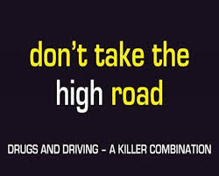
Effects of Drugs on Driving
Attention:
Divided, not focused
Tracking:
Staying in lane of travel:
Weaving/ Wrong-way
Maintaining proper distance
Perception:
Predominately visual
Environment
Glare
Dark and light
Notes:
Attention/concentration
Tracking: LE probable cause for a MV stop

Slide 15
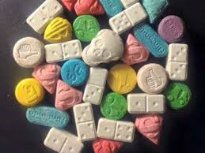
Pharmacodynamics/ -kinetics
Pharmacodynamics:
The study of effects of drugs in the body
“what a drug does to us”
Categories
Notes:
CNS stimulants, CNS depressants, and hallucinogens

Slide 16
Drug Classifications
Classes of drugs and/or metabolites:
CNS Stimulants
CNS Depressants
Narcotics
Hallucinogens
Inhalants
Overlap with CNS effects
Notes:
Commonly seen; routinely screened for
CNS: predominantly brain and spinal cord; messages sent to peripheral areas

Slide 17
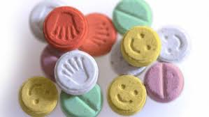
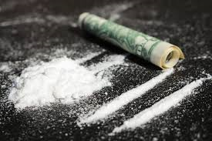
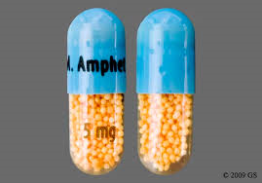
CNS Stimulants
Cocaine
Amphetamine (Adderall), MDA (Sally),
Methamphetamine, MDMA (Ecstasy, Molly)
Methylphenidate (Ritalin)
Schedule II drugs
Notes:
Cocaine: Salt: inhaled; Free-base: smoke/inhale, crack; some medicinal use: ENT procedures
Amphets: Rx and illicit; narcolepsy and ADHD in children.
Methamphet: obesity, appetite suppressant
Ritalin: similar to amphet, for ADHD
Bath salts and synt. THC

Slide 18
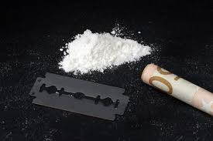
CNS Stimulants
Physiological and psychological effects:
Increased brain activity/alertness
Quick speech/ movements
Restlessness/ agitation/ fidgety/ pacing
Hyperactivity
Increased BP, HR
Feelings of euphoria/ superiority/ paranoia
Highly addictive
Withdrawal symptoms
Notes:
Increased activity in brain and body
To lessen fatigue, increase alertness, suppress appetite

Slide 19
Cocaine DUID Case
35 YO male driver
PO observed MV approaching at a high rate of speed
Estimated 60 mph
Tailgating
Aggressive behavior:
Yelling and argumentative
Dilated pupils
Toxicology findings:
Positive cocaine
Notes:
Posted-speed limit: 35 MPH zone
Yelling at the PO during the interview and SFST

Slide 20
CNS Depressants
Psychological/ Behavioral Effects:
Sleeping, lessen anxiety
Difficulty thinking and processing thoughts
Impaired judgement
Diminished concentration, memory, attention
Drowsiness
Physiological Effects:
Slurred speech
Increased reaction time
Muscular incoordination/ loss of balance
Notes:
Confusion
Driving: weaving in lane of travel, striking other vehicles, striking fixed objects, slow speed

Slide 21
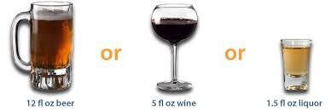
Ethanol/ Ethyl Alcohol
C₂H₅OH
Colorless liquid, generally diluted in water
Most frequently seen drug in FTL
CNS Depressant
Potentiation with other CNS depressants, ex. narcotics, barbiturates, tranquilizers
May mask other drugs present
Blood alcohol level is proportional to the concentration of ethanol in the brain
Notes:
Additive effect; synergy; enhanced effects

Slide 22
CNS Depressants
Reduce anxiety, induce sleep, or dull senses
Drugs:
Barbiturates
Benzodiazepines
Narcotics
Anti-histamines/Allery: Diphenhydramine (Benadryl)
Sleeping aids- Ambien, Sominex
Muscle relaxants- Soma, Flexeril
Cold/Flu meds
Notes:
Most drugs are CNS depressants
GABA: neurotransmitter
Barbiturates: sedative-hypnotics; sleeping meds; ex. Fiorinal/butalbital

Slide 23
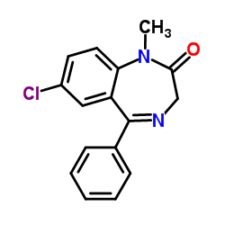
Benzodiazepines
Anti-anxiety
OCD
Panic disorders
Tablet or IV form
Most commonly seen Rx med.
Diazepam/ Valium
Alprazolam/ Xanax
Clonazepam/ Klonopin
Benzene ring, Diazepine ring
Long or short acting
Designer “Benzos”
Notes:
Diazepine ring: 7 membered ring with 2 N
Enhance the effects of GABA
Designer benzos: clonazolam, phenazepam not approved for medicinal use, not FDA approved, not DEA scheduled

Slide 24

Narcotic Analgesics
Most commonly prescribed drug
Potent painkillers
Opiates/ Opioids
Strong CNS depressants
Highly addictive
Sedation/ sleepiness, nodding off
Respiratory suppression
Receptors
Schedule II
Schedule I
Notes:
Opiates: naturally occurring from opium/ poppy plant; morphine, codeine, opium
Opioids: semi-synthetic (heroin, hcd, oxc), synthetic (fent, tram)

Slide 25
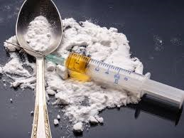
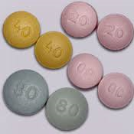
Opiates/ Opioids
Rx or illicit:
Morphine/ heroin
Codeine
Oxycodone
Hydrocodone
Methadone
Tramadol
Fentanyl
Fentanyl analogs
Notes:
Illicit fentanyl: easier to make than heroin; less costly; chemicals, no plants needed

Slide 26
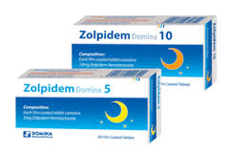
Zolpidem
Prescription Drug
Trade name: Ambien
CNS depressant
Fast acting sedative hypnotic
Prescribed for short-term treatment of insomnia
Dose taken immediately before bedtime
Do not take with alcohol or CNS depressants
DEA Schedule IV controlled substance
Known to cause sleep-walking, -eating, -driving
Top 10 drugs found in impaired motorists

Slide 27
Zolpidem DUI Case 2014
Fifty-four year old female
Reports of a MV operator driving over neighborhood lawns and striking her SUV into her garage
Officers report female sitting in the driver’s seat with the engine running and MV pinned up against the garage door
The gear was in “Drive”
Driver staring straight ahead in a trance-like state.
PO request that the SUV be put into “Park” and she stated “It is and my friend is driving”

Slide 28
Zolpidem DUI Case 2014
She then put the SUV into reverse.
Disoriented
Mumbled speech
Incapable of answering simple questions
Unsteady on her feet
Denied using alcohol or drugs that day
Toxicology finding:
Negative alcohol
Positive Zolpidem
Repeat offender from two years prior
Notes:
Prior case: same drug; <1 mile from her house

Slide 29
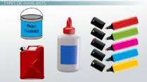
Inhalants
Chemical products
More frequently used by younger people
“Huffing”
Used to change one’s mental state
Effects on driving:
Impaired thought process
Hallucinations
Delusions
Dizziness
Muscular incoordination
Disorientation

Slide 30
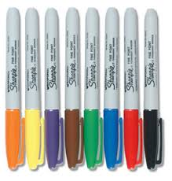
Inhalants
Glue
Gasoline
Paint thinner
Dust-off
Sharpies
Spray Paint
Nitrous oxide

Slide 31
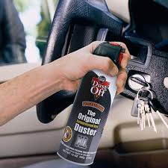
“Huffing” Case
23 YO male driver
Slumped over steering wheel
Driving through a parking lot
A witness honked her horn
Accelerated the MV, went over a curb, and hit a parked car
PO found computer dusting spray
Toxicology finding:
1,1-difluoroethane

Slide 32
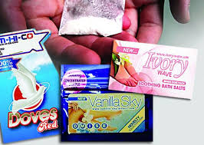
Hallucinogens
Altered perception of reality
Visual
Auditory
Emotions
Marijuana (THC)
Synthetic Cannabinoids
Bath Salts
LSD
PCP
Psilocybin/ Psilocin
Notes:
LSD: extremely potent hallucinogen
PCP: angel dust; easy to make; clandestine labs
Psilocybin: magic mushrooms
Synthetic cannabinoids: contain no THC; pestisides or chemicals; not FDA approved or fit for human consumption
Bath salts: similar to syn THC; stimulant

Slide 33
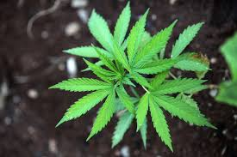
Marijuana
Cannabis plant
THC active component
Hashish, hash oil
Smoked or eaten
Used for treating chronic pain and nausea
Addictive
Withdrawal
Attributed to decreased motivation
Increased inactivity
Hallucinogen and CNS depressant
Notes:
Hashish: more potent form , made from the flowering tops of the plant
Hash oil: cooking the plant material with a solvent to remove the plant resin; evaporated to get a thick oily material which almost pure resin
Edibles
Hallucinogen and CNS depressant activity
CB1,2 receptors
Various laws in the US: medicinal, decriminalized, legalized

Slide 34
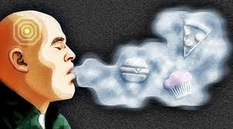
Marijuana
Targets cannabinoid receptors in the brain:
Effect:
Perception
Memory
Mood
Sleep
Appetite
Most frequently found illicit drug in drivers involved in a motor vehicle accident
Notes:
CB1 And CB2 receptors

Slide 35
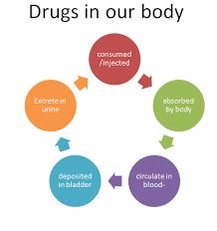
Pharmacodynamics/ -kinetics
Pharmacodynamics:
The study of effects of drugs in the body
“what a drug does to us”
Pharmacokinetics:
The study of drugs in the body
“what we do to a drug”
ADME:
Notes:
Looked at types of drugs and their effects. Now let’s look at the human body and what it does to these drugs

Slide 36

Absorption- Ethanol
Alcohol appears in the blood within minutes after consumption:
Stomach and small intestines
Complete in generally 30-90 minutes
Maximum BAC is reached
Post-absorption
Notes:
Absorption: passage of alcohol across the walls of the stomach and small intestine into the bloodstream
20% stomach

Slide 37
Absorption Rate- Ethanol
Depends on:
Amount of alcohol consumed
Type of drink
Time of consumption
Presence of food in the stomach
Health of the individual
Notes:
Alcohol content: type of drink
Physiology: health, ex. Liver disease

Slide 38
Absorption- Drugs
Most concentrated at the point of entry
Routes of administration:
Oral:
GI tract, stomach, intestines, and liver
Inhalation:
Through the lungs; “huffing” solvents, gases, smoking
Rapid absorption
Intravenous:
Most efficient; drug administered directly into the bloodstream; bypass the stomach and liver

Slide 39
Absorption- Drugs
Intranasal:
Insufflation; snorting; cocaine, heroin
Intramuscular:
Less efficient; slower transfer to the bloodstream
Sublingual:
Oral mucosa, tongue
Rapid absorption
Dermal:
Patches: fentanyl, nicotine
Notes:
Intramuscular: less efficient; sublingual: oral mucosa, under the tongue, film; dermal: patches: fentanyl, nicotine: drug distributed over time

Slide 40
Distribution
Ethanol:
Carried to watery parts of the body
Blood, brain, vitreous humor
Transfer from blood into the tissues
Distributes to heart, liver, kidney, and brain
Muscle and fat more slowly
Volume of distribution: theoretical value
Vd= D/C
Ex: Alcohol: <1; Amitriptyline: 11-18
Notes:
Alcohol: small compound; distributes to areas based on the water content
Amitriptyline: complex molecule; distributes mostly to tissues

Slide 41
Metabolism
Process of altering the drug to eliminate it from the body
Detoxification process
Primarily in the liver
Phase I:
Transform functional groups
May form other active compounds (metabolites)
Ex. Diaxepam/ Valium; Nordiazepam
Phase II:
Mostly inactive, water soluble compounds
Notes:
Pro drugs: metabolite more active

Slide 42
Elimination
Excretion
Final removal from the body
Kidney and liver
Exception:
EtOH: also eliminated through the lungs and sweat
Drugs also eliminated into breast milk
Elimination rates:
Zero order: constant amount cleared from the blood per unit time; ex. EtOH
First order: constant fraction of drug is removed from the blood per unit time; half-lives
Notes:
Some drugs eliminated quickly: heroin, THC
Benzos: midazolam: fast; anesthetic in surgery; Klonopin: longer; therapeutic use

Slide 43
Elimination- Ethanol
Oxidation:
Liver enzymes
95% to CO₂ and water
Excretion:
5% unchanged state
Breath, sweat, and urine
Amount of alcohol exhaled in breath is proportional to BAC
Henry’s Law
2100:1 mL
Notes:
Oxidation: combination of oxygen with other substances to produce new products
Liver enzymes: alcohol dehydrogenase
Alcohol to acetaldehyde to acetic acid; to CO2 and water
Breath: CO2 and OH
Henry’s Law” fixed ratio between concentration of alcohol in alveoli breath and its concentration in blood
Elimination rate: 0.015-0.03 %/hr.

Slide 44
The Process of a RI DUID Case
Establish probable cause:
Observation of improper driving or equipment violation by a PO
Evaluation /interview of the driver
Standardized Field Sobriety Tests performed outside of MV
Blood collection
Blood samples taken and submitted to the FTL
Notes:
SFST: walk and turn, one leg stand, horizontal gaze nystagmus
Blood collection: medical facility; airtight tubes with chemicals: preservatives to prevent bacterial growth and anti-coagulants to prevent clotting

Slide 45
Blood vs. Urine
Blood specimen necessary to determine impaired driving
Blood is circulating throughout the body
In equilibrium with the brain
Present in the CNS
Urine is an end-product of biological processes:
Absorption, Distribution, and Metabolism
Pooled sample over time
Drugs present for days-weeks
May not be present in the blood
Notes:
Urine outside the circulatory system
Cannot establish impairment from a urine sample

Slide 46
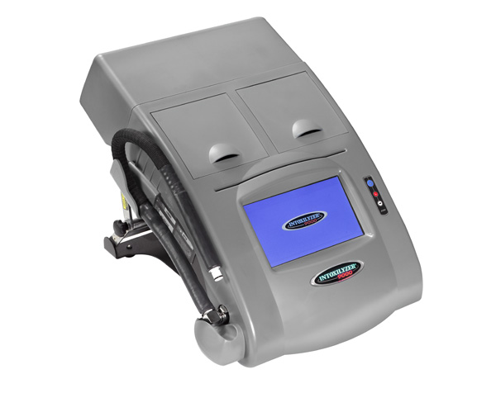
Blood vs. Breath
Breath is an easily obtainable, non-invasive sample for testing alcohol use.
Provides a fast and accurate result.
Breathalyzer instrument cannot detect drugs

Slide 47
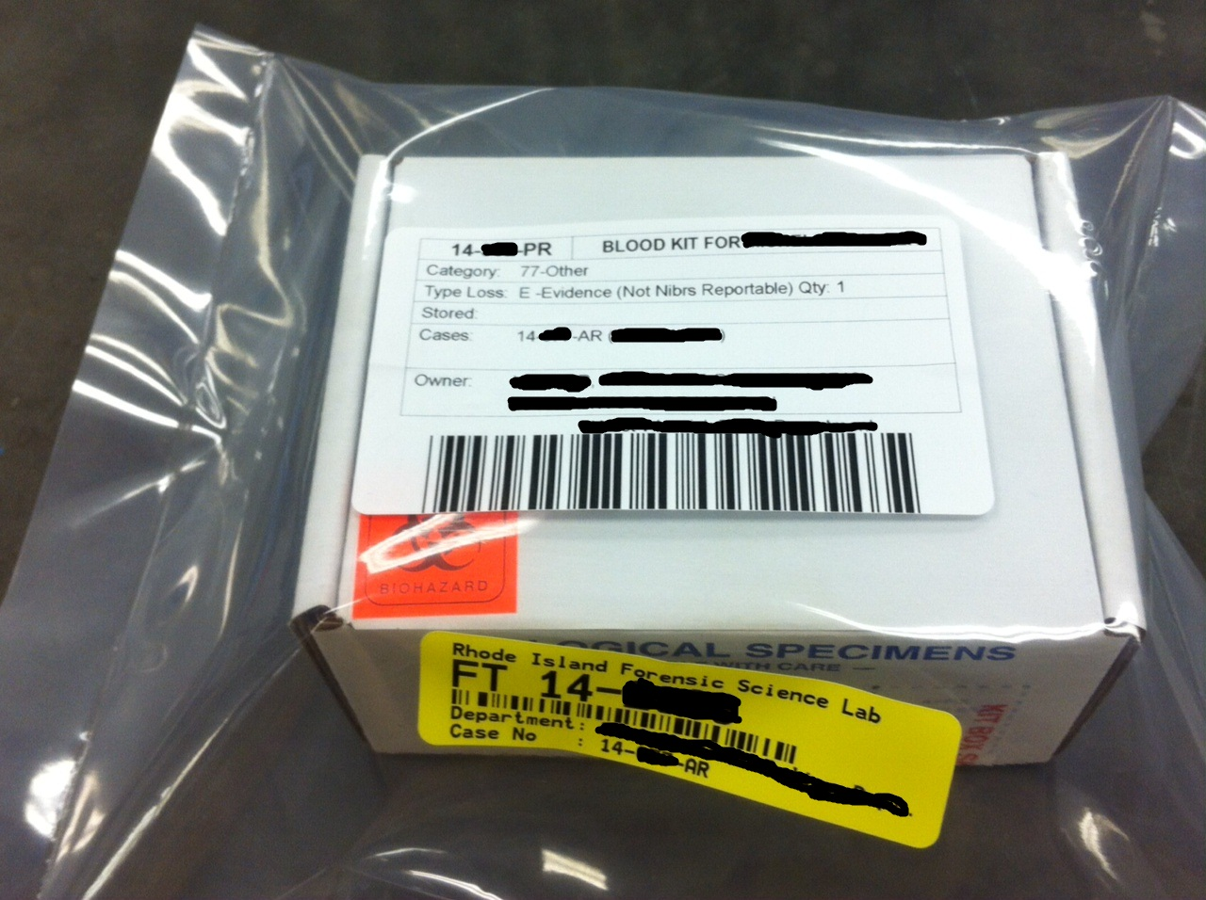
FTL Evidence
Notes:
Collection kit, biohazard label, outer plastic bag to prevent leakage during handling, storage, and transport
OSHA regs regarding potentially hazardous material

Slide 48
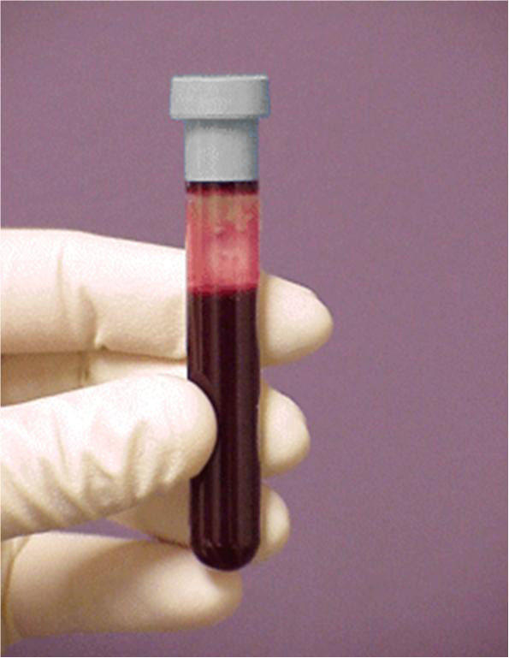
Specimen Tubes
Notes:
Tubes: labels and evidence seals: date and time of draw, initialed
Preservatives and anticoagulants

Slide 49
DUI Scope of Testing
Ethanol/Volatiles/Inhalants
Drugs: 2 steps
Preliminary screening
Presumptive result
Classes of drugs
Confirmatory testing:
Specific/directed testing
Two different test methods necessary to report a positive result

Slide 50
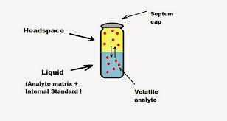
Alcohol Testing
Headspace Gas chromatography
Separation technique
Partition effect:
Stationary phase
Mobile phase
Flame ionization detector
RT
Well established and accepted
Highly specific and sensitive
Notes:
Sample is volatized
Stationary phase: column in an oven
Mobile/moving phase: helium carrier gas
Hydrogen gas detector

Slide 51
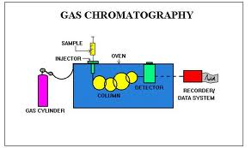
Gas Chromatograph
Notes:
Sample is volatilized; Helium carrier gas, headspace technology, vaporized sample reaches the detector, Hydrogen detector; data is interpreted as a peak on a chromatogram

Slide 52
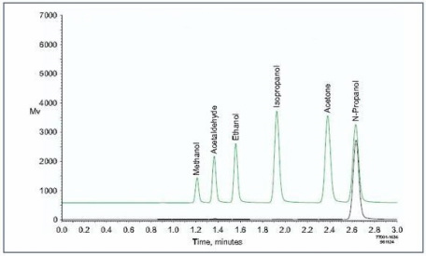
GC Volatiles Chromatogram
Notes:
Time vs. Absorbance
Quant by comparing peak area to known standards and calibrators, ISTD

Slide 53
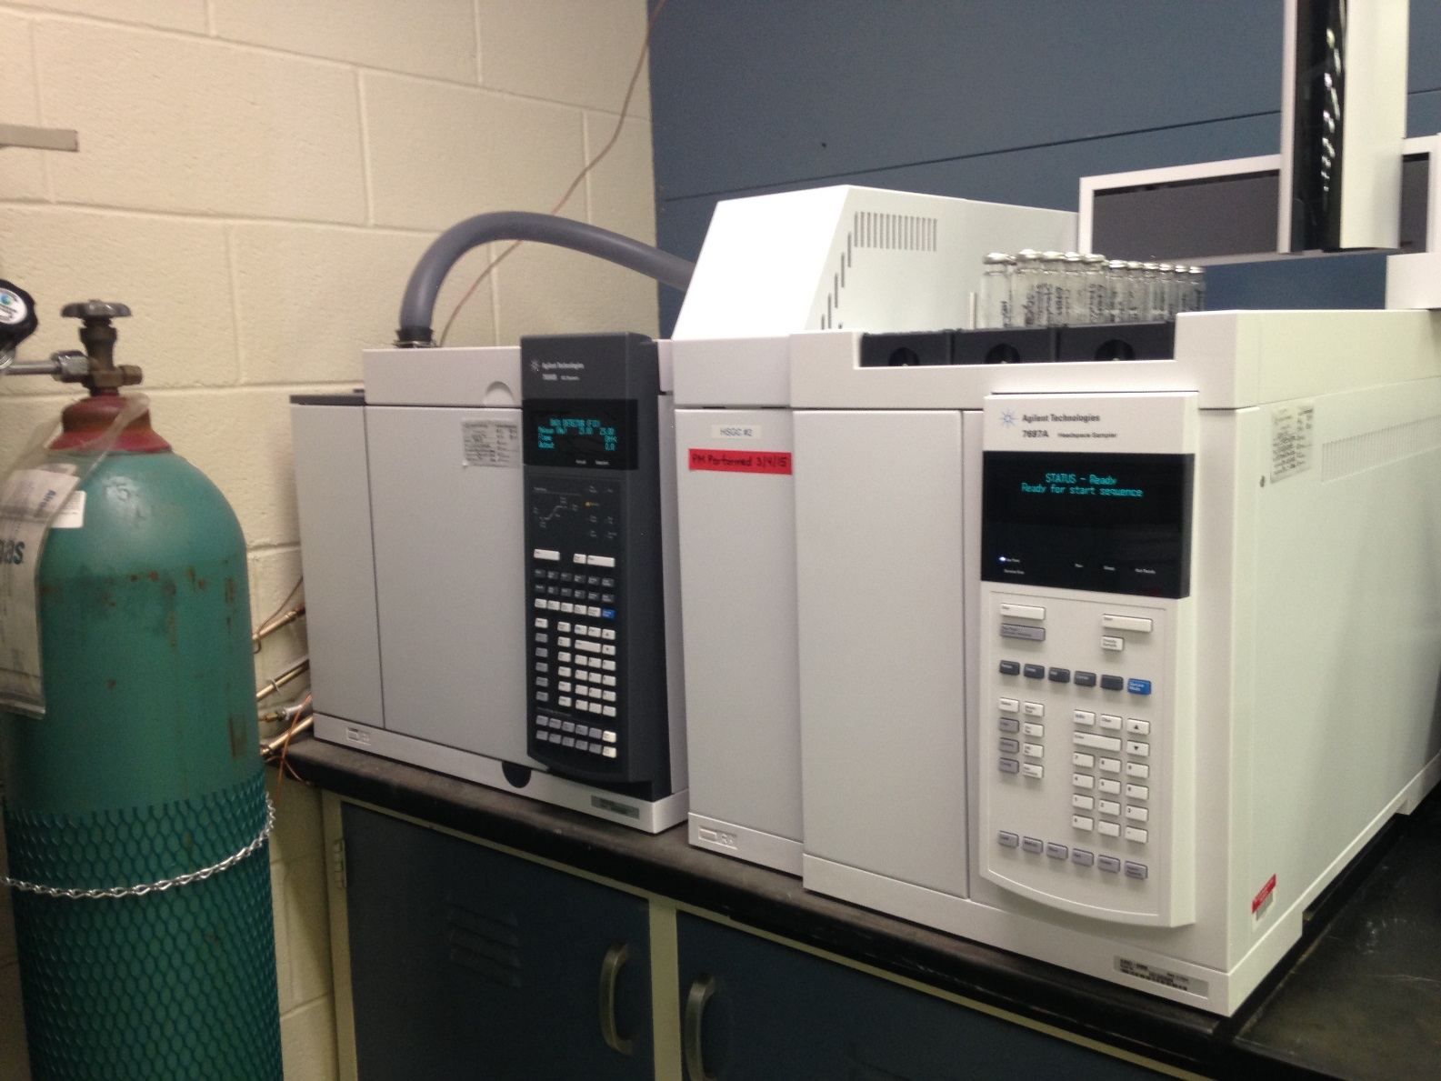
Headspace Gas Chromatograph

Slide 54
Terminology
Sensitivity:
Measure of the method’s ability to detect an analyte
Distinquish true negatives from true positives
Limits of detection and quantification
Specificity:
Measure of the method’s ability to correctly identify an analyte
Cross-reactivity
Ex. Immunoassays, Confirmatory tests
Notes:
ELISA: less specific but sensitive
GC/MS: sensitive and specific

Slide 55
Forensic Drug Testing
A two step process:
Preliminary screening:
Immunoassay
Confirmatory testing:
GC
GC/MS
LC/MS
Well established and accepted techniques
Notes:
Tandem instruments: MS/MS
Many drugs
Techniques validated in the forensic community

Slide 56
Comprehensive Drug Testing
Classes of drugs and/or metabolites:
CNS Stimulants
CNS Depressants
Narcotics
Hallucinogens
Inhalants
Illicit and Rx

Slide 57
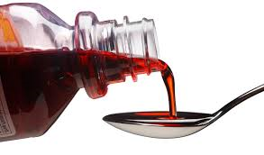
Prescription and OTC Drugs
Anti-depressants
Anti-psychotics
Muscle relaxants
Anti-seizure
Cardiovascular
Cold/Flu Meds
Cough syrups
Anti-histamines
Sleeping aids
Notes:
OTC: CNS depressants
Dextromethorphan
Diphenhydramine/Benedryl
Sleeping aids: RX or OTX; ex. Unisom/ doxylamine

Slide 58
Preliminary Tests
First step in forensic drug testing
“Immunoassay”
Presumptive Screens
Qualitative assays
Classes of drugs
Disadvantages:
Limited scope of testing
False negatives and positives are possible
Not forensically defensible without confirmation
Notes:
Absence or presence only
False positives: PM decomp w/ amphets
False negatives: rare; d/t amount present and sensitivity of the assay; may give indication; target drug or metabolite

Slide 59
ELISA Test
Enzyme linked immunosorbent assay
Competitive binding
Antibody-Antigen reaction
Advantage:
Automated
High sensitivity
Applicable to blood and post-mortem specimens
Disadvantage:
Low specificity
Notes:
Sensitivity: detect low levels, ng/mL

Slide 60
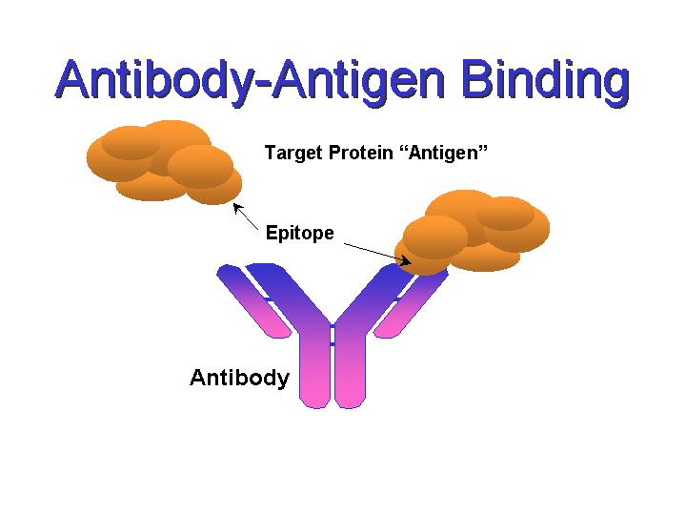
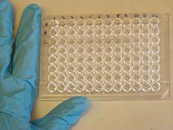
ELISA Screening Test
Antibody-Antigen Reaction
Notes:
Plate is coated with specific drug antibody;
Fab: fragment antigen binding

Slide 61
ELISA Process
Antibody coated plates
Sample + Conjugate
Incubation/ competitive binding
Wash
Substrate
Reader
Measures absorbance of conjugate in sample and standards
Inversely Proportional
Notes:
Competitive binding
Wash unbound material
TMB substrate for color reaction
Color development is inversely proportional to the amount of analyte in the sample to standard: ex. Absence of analyte in the sample will result in a dark blue color; presence of an analyte will result in a light blue color

Slide 62
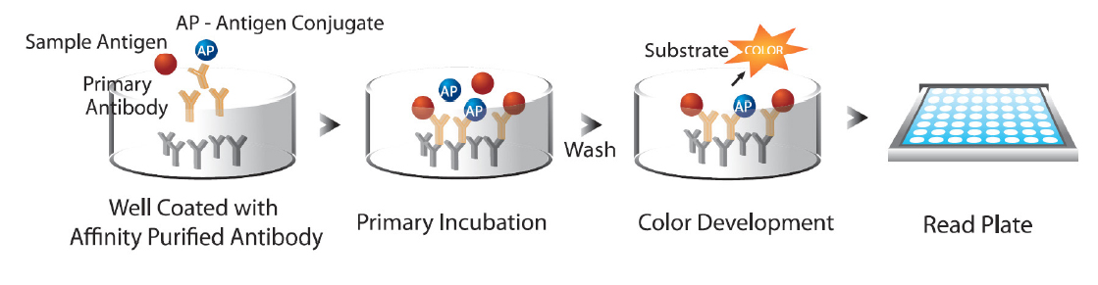
ELISA Principle

Slide 63
ELISA Preliminary Testing
Notes:
Fentanyl: opioid; potent pain killer; Rx and illicit
Determined cut-offs for each assay; run in duplicate;
Reaction: inversely proportional: >drug present, <absorbance measured: measuring assay specific reaction
Positive or negative result

Slide 64
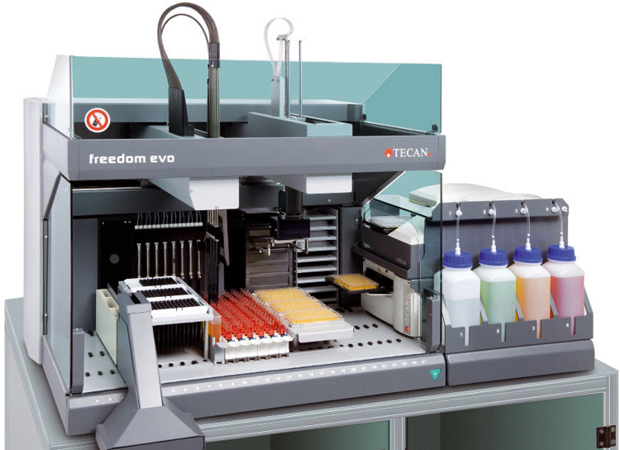
ELISA Tecan System
Notes:
Instrument used for drug screening; automated- sampling, washer, and reader components; w/ computer for data analysis
Immunoassay technique
ELISA is a competitive binding technique: antibodies in the test kit combine with antigens in the sample, if present
Analyzes whole blood

Slide 65
Confirmatory Testing
Second phase of forensic drug testing
All positive screening tests require confirmatory test utilizing a more specific and sensitive chemical principle.
Qualitative or quantitative analysis
Gas or liquid chromatograph
Mass spectrophotometer detector
GC/MS or LC/MS
Notes:
GC separates the various components of sample –involves stationary phase of GC column and molecular weight of analytes. MS bombards with high energy electrons, causing sample to break into fragments. Fragmentation pattern represents a unique “fingerprint” pattern used for identification. (Cocaine-82, 182, 303 due to molecular structure.)
Vaporize, ionize & fragment cpd.
Mol. Wt. & abundance of fragments-specific for each cpd.
Electron multiplier used.

Slide 66
Confirmatory Testing
Detect and identify specific drugs present
Broad scope of analytes, including metabolites
Detect minute amounts
Forensically defensible
Widely accepted methodology
Extensive scientific literature and information
Requires separation of the drug from the sample matrix
Labor intensive
Expensive instrumentation
Notes:
Minute amounts: unlike drug chem- pills and powders

Slide 67
Analytical Overview
Blood specimen
Isolate the drug/analyte of interest
Chemical property of the drug
Liquid-liquid extraction
Solid phase extraction
Analysis:
HPLC, GC, GC/MS
Data Processing/Review/Interpretation
Notes:
Isolation using an appropriate extraction method
Drug: pH; acid, neutral, or basic; barbs, antidepressants

Slide 68
Liquid-liquid Extraction
Most frequently used technique
pH adjustment with buffer, acid, or base
Extract with an organic solvent
Hexane, chloroform, dichloromethane
Property of the drug of interest:
? Acidic, neutral, or basic drug/ functional groups
Good recoveries but time consuming
Notes:
Ex. Amine/ nitrogen or Sulphur drug
Cocaine is an alkaloid; basic drug

Slide 69
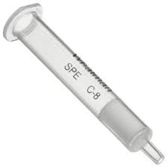
Solid Pase Extraction
Commercially prepared columns
Contains sorbent/ resin/ silica
Series of steps
Acid, neutral, basic drugs
Fully automated
Analyze
Notes:
Excipients

Slide 70
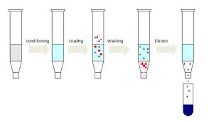
Solid Pase Extraction
Notes:
Excipients

Slide 71
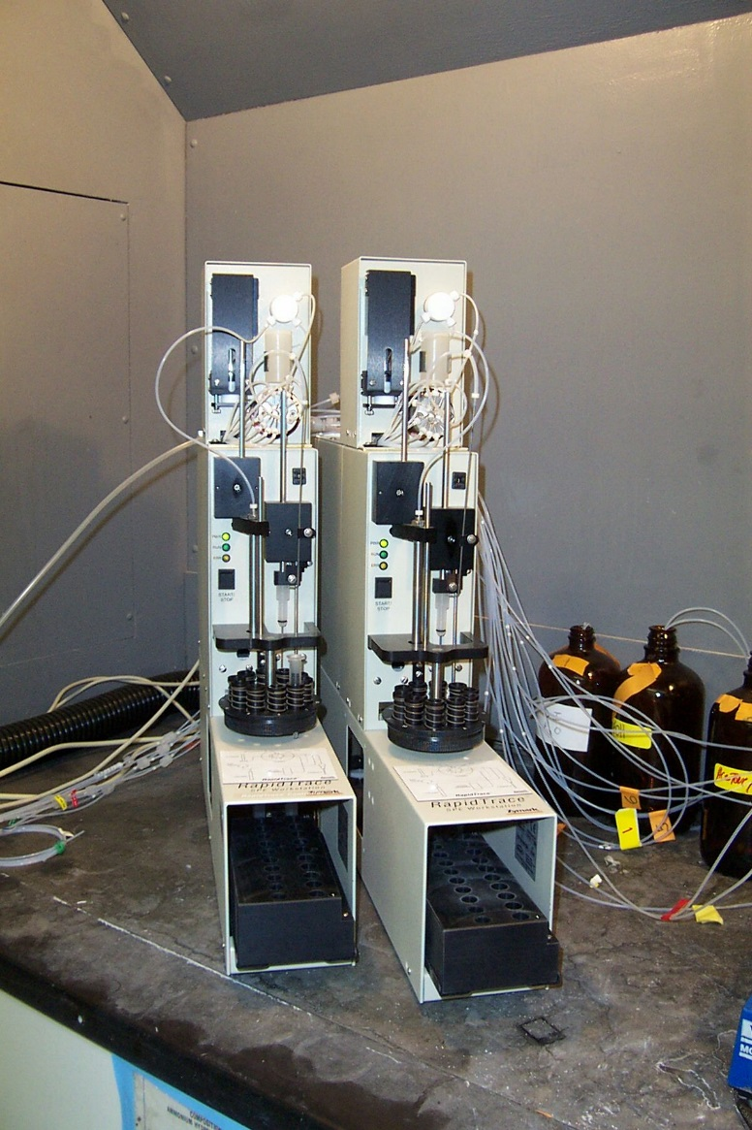
Solid Phase Auto-extractor
Notes:
Involve solvent/solvent procedures

Slide 72
Mass Spectrometer Detector
Coupled with GC or LC
Identifying technique
Inlet, electron ionization, bond breaking and fragmentation, analyzer, detector
Resulting in a drug “fingerprint”
MS database/ library
Highly accurate, sensitive, and specific
Notes:
LC: liquid chromatography; liquid mobile phase; HPLC; RT; separated compounds
Ion source; mass analyzer
Detector: measures the separated ions and produces a chromatogram
No two drugs produce the same fragmentation pattern

Slide 73
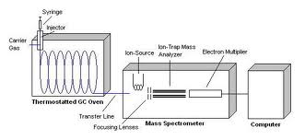
GC/MS System
Notes:
Helium carrier gas

Slide 74
GC/MS TIC
SKF-525A:
Proadifen
Internal Standard
2 unknown peaks
Notes:
Internal Std: added to all samples to check efficiency of extraction and used for quantifying; normally the largest peak
Ex. Of blood from decedent
General drug screen; 30 minute run time
X and Y axis: time vs. abundance
known retention times; compare to calibrators and standards

Slide 75
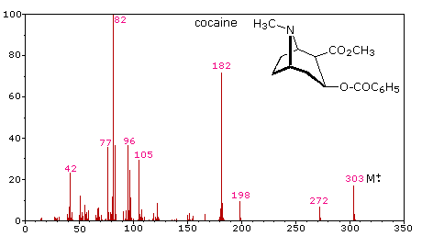
GC Mass Spectra
GC/MS Cocaine chromatogram
Notes:
Significant ions

Slide 76
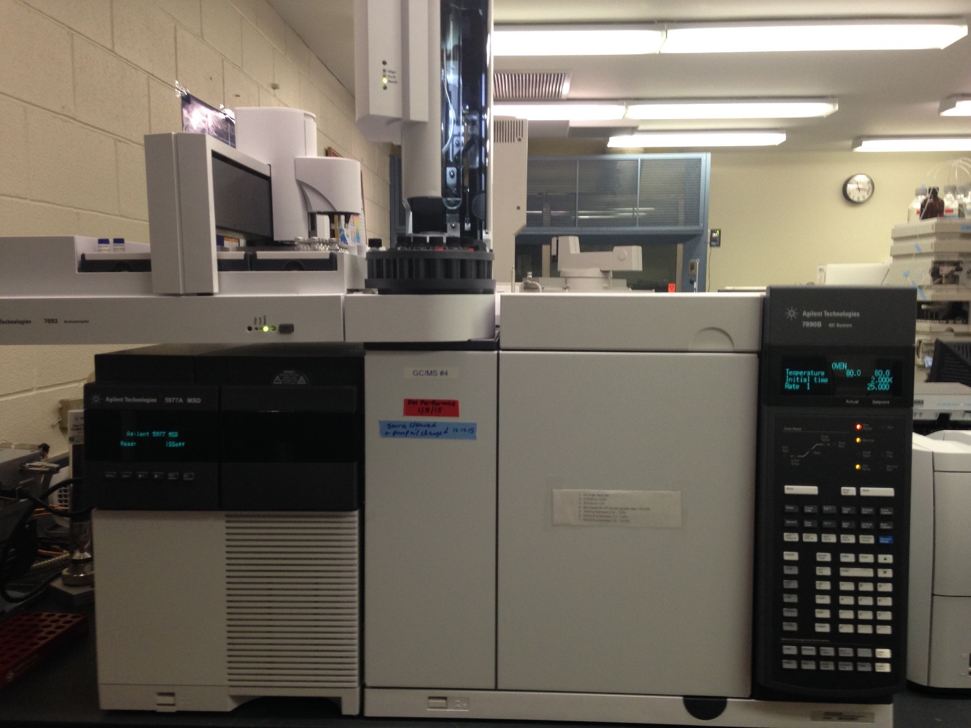
GC/MS System

Slide 77
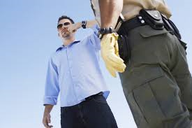
Interpretation
A toxicologist can:
Test the sample
Interpret the analytical result
Testify clearly to the effects of drug present in the driver

Slide 78
Interpretation
A toxicologist cannot:
Determine impairment in a specific individual from a single blood result
Determine how much drug was taken
Determine exactly when a drug was taken

Slide 79
Interpretation
Is the driver impaired?
Cannot give an opinion based solely on positive toxicology results
Need information gathered by the investigator at the scene
Observations, situation, environment, SFSTs
Notes:
Observations of the driving pattern

Slide 80
Drug Interpretation Issues
No legal guidelines
Case-by-case basis
Polypharmacy/multiple drug use:
Synergistic effect with other like drugs
Mixed classes
Individual tolerance
Metabolites
Notes:
Poly-pharmacy: interaction with other drugs
Tolerance: past use; acute or chronic

Slide 81
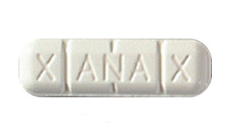
2018 Toxicology Stats
188 DUI cases submitted
96.3% DUI cases positive for ethanol or drugs
50% Positive Ethanol
Ave. BAC= 0.18 g% ethanol
66% Positive Drugs
Drugs: THC, Fentanyl, Cocaine, Methadone,
Benzodiazepines
22%: Ethanol + Drugs
Notes:
Blood kits for alcohol and drugs; seems like a low number; factor in breath testing – no drugs

Slide 82
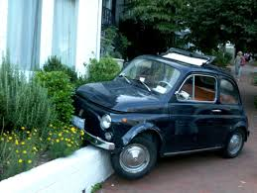
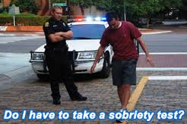
Conclusion
Individual impairment increases as a drug’s concentration increases in the body
Ethanol and drugs effect a driver’s ability to safely operate a MV and increase the risk of a MV crash
Do not mix alcohol and drugs

Slide 83

Robert Almeida, MS, D-ABFT-FT, TC-NRCC
Supervisor, Forensic Toxicology
401.222.5565
robert.almeida@health.ri.gov

