Slide 1
Complementary Toxicology: Introduction to a Cool Forensic World
Carl M. Selavka, Ph.D., D-ABC
Forensic Analytical Chemist
Northeastern Bioscience Associates, LLC Charlton MA

Slide 2
Disclaimers
The opinions expressed in this presentation are those of the author and do not represent the official positions of any agency, corporation, or scientific body. The author does not purport to provide accurate, reasonable, intelligent or timely advice. Past performance is not necessarily a guide to future performance. The attempted humor is admittedly lame.

Slide 3
Bottom Line Up Front
Diverse Investigative Power
“Complementary” Tox = Good
Alcohol Bio-Markers = Another Tox Example to Drive You Nuts
Uncontrolled Factors = Forensic Reality

Slide 4
The Quality Triangle
Certification
Quality
Forensic
Services
Accreditation
Standardization
Notes:
3

Slide 5




Slide 6
FEPAC
Forensic Science Education Programs Accreditation Commission
Notes:
5

Slide 7
Quality Rectangle
Educational Harmonization
Quality
Forensic
Services
Certification
Accreditation
Standardization
Notes:
3

Slide 8
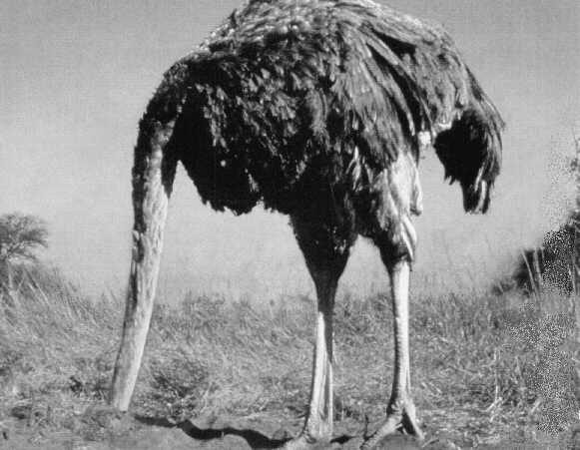
Toxicology Is Perfect

Slide 9
Tell us About the Science of Drug Testing

Slide 10
Drug Screening
Fast & Sensitive
Highly Automated

Slide 11
Drug Screening
Fast & Sensitive
Highly Automated
Semi-Quantitative
Detects Groups of Drugs

Slide 12
Confirmation
Separate Drugs & Metabolites
Incredibly Sensitive
Accurate Quantitation
Labor Intensive

Slide 13
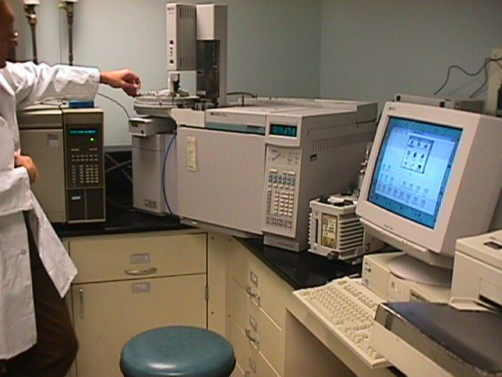
I’m a Gas Chromatograph / Mass Spectrometer!
I Can Detect MicroFarts
of Drugs & Metabolites!

Slide 14
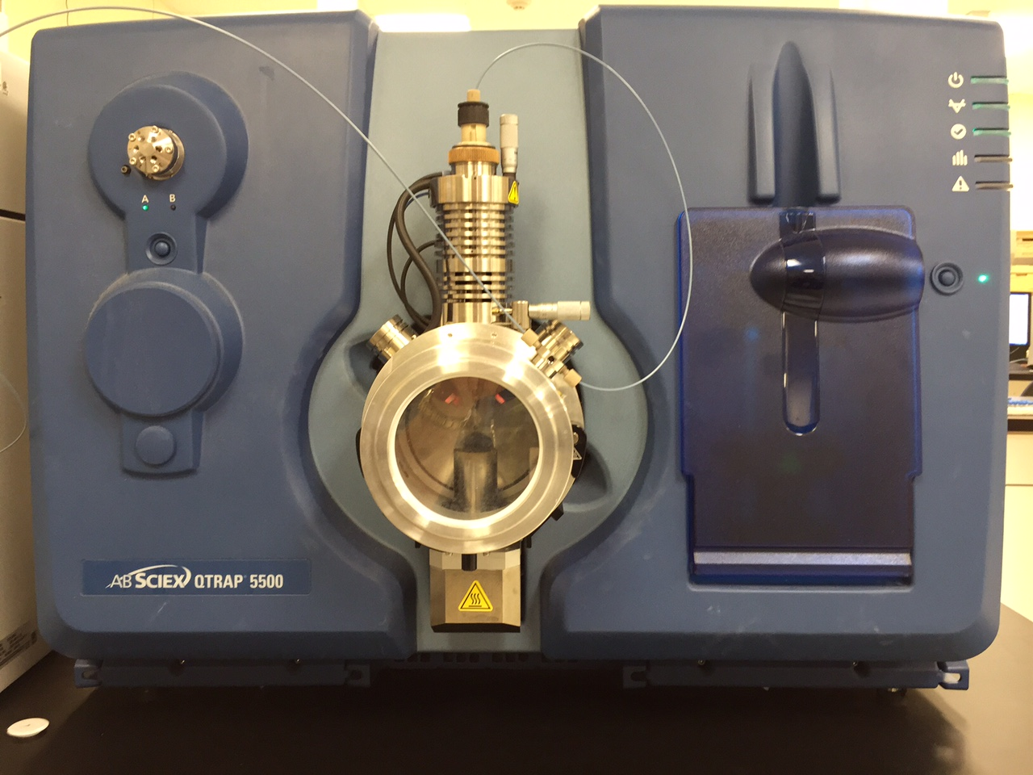
I’m an even smarter Liquid Chromatograph tandem Mass Spectrometer
(LC-MS/MS)!

Slide 15
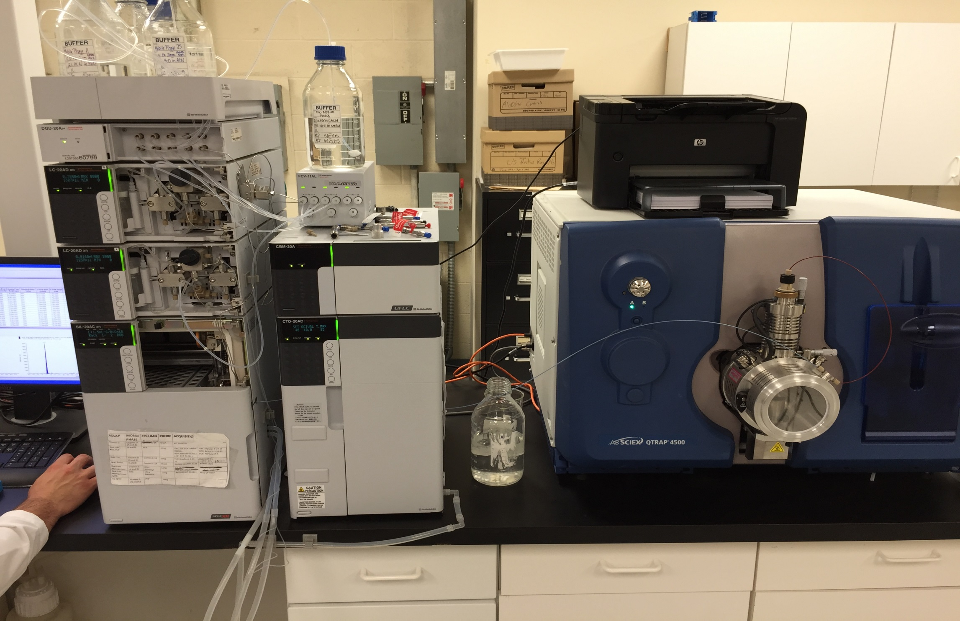
Dual Pumps
Mobile Phases
Spare
Columns
Autosampler
Sample Tray
& Injector
MS/MS uniquely identifies
the separated drugs
and metabolites
HPLC (Separation)
Columns in a controlled
temperature zone

Slide 16
Toxicological Analytes of Interest
Alcohol: King of the Universe (Well….At Least King of the URI Universe?)
Benzodiazepines: The “Pam” Family of 20
Gamma-Hydroxybutyric Acid (GHB): Is it a Bigger Problem than Roofies? DFSA…
Central Nervous System (CNS) Depressants (You Name it, Someone Died From It….)

Slide 17
Toxicological Analytes of Interest
Opiates and Opioids: (Dilaudid, Percocet/dan)
Fentanyl & its Analogues
Cocaine: Queen for a Week…
Marijuana: (“Old” Chemotherapeutic and “New” Medical Apps plus Synthetic Analogues)
Sympathomimetic Amines (“Amphetamines” and the Alternative “Rave” Scene Drugs)

Slide 18
Toxicological Analytes of Interest
Hallucinogens: Stamps & ‘Shrooms
“Healthy” Therapeutics: Anticonvulsants & Antiarrhythmics
“Happy” Therapeutics: Antidepressants
“Crazy” Therapeutics: Neuroleptic (AntiPsychotics)

Slide 19
Toxicological Analytes of Interest
All the Rest of Those Toxicologically- Important Analytes:
  Carbon Monoxide
  Cyanide
  Inhalants
  Metals
  Pesticides
  Herbicides
  You Name It, Someone Was Killed With It

Slide 20
Millenial Analytes of Interest
Kratom, Krocadile & Other Little Fish
Designer Stimulants (“Bath Salts”)
Legal Marijuana (26 States: Medicinal + Recreational; ALL States: CBD (but watch out for THC…)
Synthetic Cannabinoids (K2 / “Spice”)

Slide 21
Millenial Analytes of Interest
Kratom, Krocodile & Other Little Fish
Designer Stimulants (“Bath Salts”)
Legal Marijuana (26 States: Medicinal + Recreational; ALL States = CBD)
Synthetic Cannabinoids (K2 / “Spice”)
  “AM-_____” means “Invented at NU”
  Thank you Prof. Alexandros Makriyannis (@ my Alma Mater)

Slide 22
Compliance Testing [ To Maintain Privileges]
Performance Testing
Postmortem Examinations
Forensic Tox “Categories”

Slide 23
Postmortem Toxicology
Forensic Toxicology Initiation
  Forensic = “Of, or Relating to, or Used in Legal Proceedings or Argumentation”
  Toxicology = “The Study of the Adverse Effects of Foreign Substances in Living Organisms (a.k.a. Poisons)”
  Early 1800s: French Research Defined the Field (AND Absorption’s Importance…Now We Have ADME)
  Mid 1800s: The French Kept it Going with Extractions
  1900s: America Finally Gets Involved (in NYC, of Course!)
Borkenstein Was a Great American

Slide 24
Performance Testing
Evaluation of Human Performance
  Can be Termed “Psychomotor” Performance
  Performance of Routine Tasks Like SPORTS!
  These Routine Tasks are Often “Privileges” Also
Psychology, Toxicology & Pharmacology
The Dose and History of Dosing are Critical
  Positive Effects vs. Negative Effects
  Chronic vs. Therapeutic
  Illicit vs. Prescription
Alcohol is ONE of MANY Kings

Slide 25
Workplace Testing
Forensic Toxicology’s Workhorse
  Safety & Security Sensitive Positions
  Interface Between Privacy & “Social Good”
Source of “Forensic” Best Practices
  Sampling, Integrity, Storage, Access Limits
  AFOMs, Complementary Tests, QA
Moving Those Cutoffs…

Slide 26
The Average Man Theory
IN
Absorption
Distribution
Metabolism
Elimination
OUT

Slide 27
Absorption
Through Skin, Lung and GI
Substance Enters the Blood
Simple Diffusion, Active
Transport Mechanisms
Carriers: (None), Plasma
Proteins or RBCs

Slide 28
Distribution
Determined by Blood Flow,
pK_{a} and Lipophilicity
Leads to Different Levels In
    Various Tissues
Site of Storage = Site of Action

Slide 29
Metabolism
Change Lipophilic Substances
    to Water Soluble Products
Primary: Liver, Lung, Kidney,
    Intestine, Skin
Secondary: Enzymatic Reactions
and Conjugation

Slide 30
Excretion
Through Kidney (Urine)
Through Liver (Bile Feces)
Through the Lungs (Breath)
“Others” - Sweat, Hair, Milk,
    Tears, Seminal Fluid, Saliva

Slide 31
More to Be Dangerous With
Absorption and Distribution
Metabolism and Excretion
Conc
Plasma
Urine
Time

Slide 32
Bottom Line In Middle
Diverse Investigative Power
“Complementary” Tox = Good
Alcohol Bio-Markers = Another Tox Example to Drive You Nuts
Uncontrolled Factors = Forensic Reality

Slide 33
Breath
Tracks
Blood

Slide 34
“Unusual Samples”
Oral Fluid Semen
Sweat Body Fluid Stains
Hair Finger / Toe Nails
Milk Stool / Meconium
Tears Skin

Slide 35
Oral Fluid Testing

Slide 36
Oral Fluid Tests & U/A
Highly Complementary
On-Site and Lab-Based Tests
Use & Interpretive Concerns
  Collection Bias / Artifacts
  Quality Control Issues
  Quantitative Validations
The Tools Improve Every Day

Slide 37
Realities of On-Site OF
PoC Tests in General:
  Selectivity Issues
  Sensitivity Issues
  “Presumptive” = Confirmation
Detection Timeliness Builds
Deterrence

Slide 38
Sweat
Testing

Slide 39
Sweat Collection
3581109

Slide 40
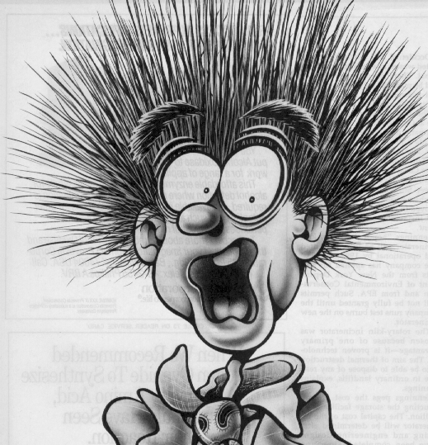
Hair
Testing

Slide 41
Hair Testing Promises
Indicates Multiple Ingestions
Distinguish Time Periods
Difficult to Evade

Slide 42
How big are the Windows of Detection?

Slide 43
“It’s All About the Half-Life” (Elimination or Excretion?)

Slide 44
Oral Fluid
Tracks Blood
(pretty closely, anyway…)

Slide 45
Absorption and Distribution
Peak Quantitative Level
Oral
Fluid
Concentration (ng/mL)
Metabolism and Excretion
Time

Slide 46
Peak Quantitative Level
Oral
Fluid
Concentration (ng/mL)
Cutoff Level
Time

Slide 47
Qualitative Reporting
Peak Quantitative Level
POSITIVE
Oral
Fluid
Concentration (ng/mL)
Cutoff Level
NEGATIVE
Time

Slide 48
Window of Detection
Peak Quantitative Level
POSITIVE
Oral
Fluid
Concentration (ng/mL)
Cutoff Level
NEGATIVE
Window of
Detection

Slide 49
Window of Detection
Peak Quantitative Level
POSITIVE
Cutoff Level
Concentration (ng/mL)
NEGATIVE
Oral
Fluid
Window of
Detection

Slide 50
“It’s (actually) All
About the
Cutoff”

Slide 51
Breath
Correlates to
Blood

Slide 52
Urine Looks Farther Back in Time

Slide 53
Drug Incorporation
into Hair
The Simple Model

Slide 54
Hair Morphology
Cuticle
Cortex
Medulla

Slide 55
Dermal Papilla
Capillary
Bed
Blood Flow

Slide 56
Undifferentiated Hair Matrix Cells
U
U
U
Drawing Serum from the
Capillary Bed

Slide 57
Differentiation of Matrix Cells
Medulla
Cuticle
I R S
Cortex
U

Slide 58
Detecting A Single Use
~ 0.3 mm
Tip (Distal)
End
Root (Proximal)
End

Slide 59
Detecting Chronic Use
Tip (Distal)
End
Root (Proximal)
End

Slide 60
Drug Incorporation
into Hair
The Complex Model

Slide 61
Complex Drug Incorporation
Particles & Vapor
Sweat
Sebaceous
Gland
Capillary Flow to
the Dermal Papilla
After Morrison
and MacCreehan

Slide 62
Complementary Alternatives
  Breath & Blood/Products = Very Recent Use or Exposure
  Oral Fluid = Recent Use or Exposure
  Urine = Mid-Range Use or Exposure
  Hair = Repetitive Use or Exposure
  Sweat = Use or Exposure During Patch Application

Slide 63
Detection Windows
Hair
Sweat Patch
Urine
Oral Fluid
Breath & Blood / Products
-8 -6 -4 -2 0 2 4 6 8
Days From Last Dose

Slide 64
Programmatic Realities
Deter Knowing & Willful Use
Optimized Applications:
  For-Cause Incidents = Blood / Oral Fluid
  Changed Behaviors = Urinalysis
  Repetitive Use Detection = Hair Tests
Observed vs. Unobserved
“Unreasonable” Searches

Slide 65
Legal Applicability
Ask as Many Questions as Possible to Optimize the Probative Nature of the Findings.
“Negative” = Happiness

Slide 66
Amphetamines
DEA Schedule I or II
Stimulants
Synthetic Products
Tablets (Ingested)
Crystal (Smoked)
Low Background

Slide 67
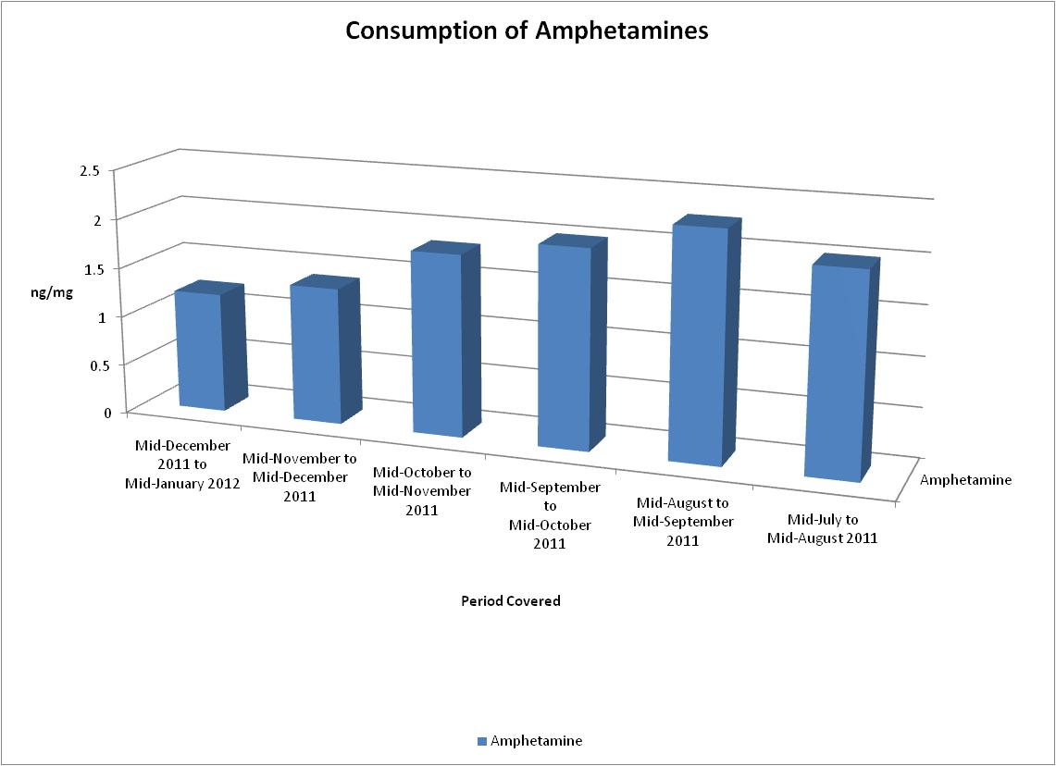

Slide 68
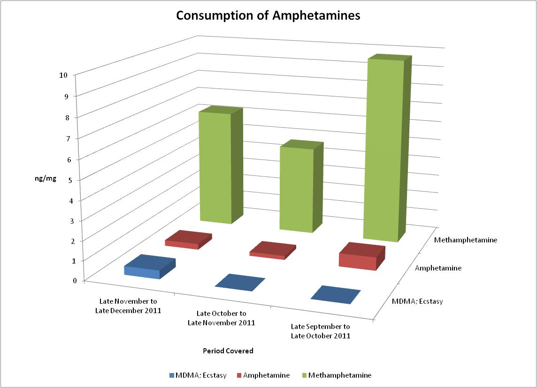

Slide 69
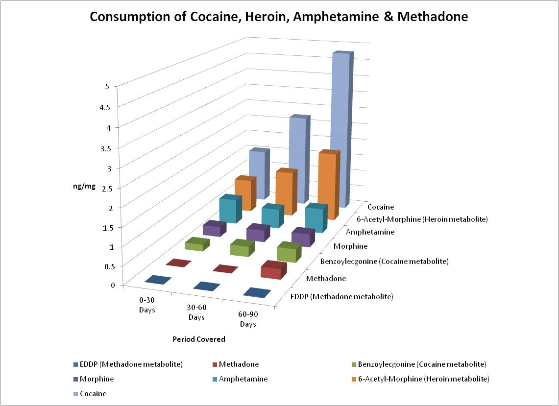

Slide 70
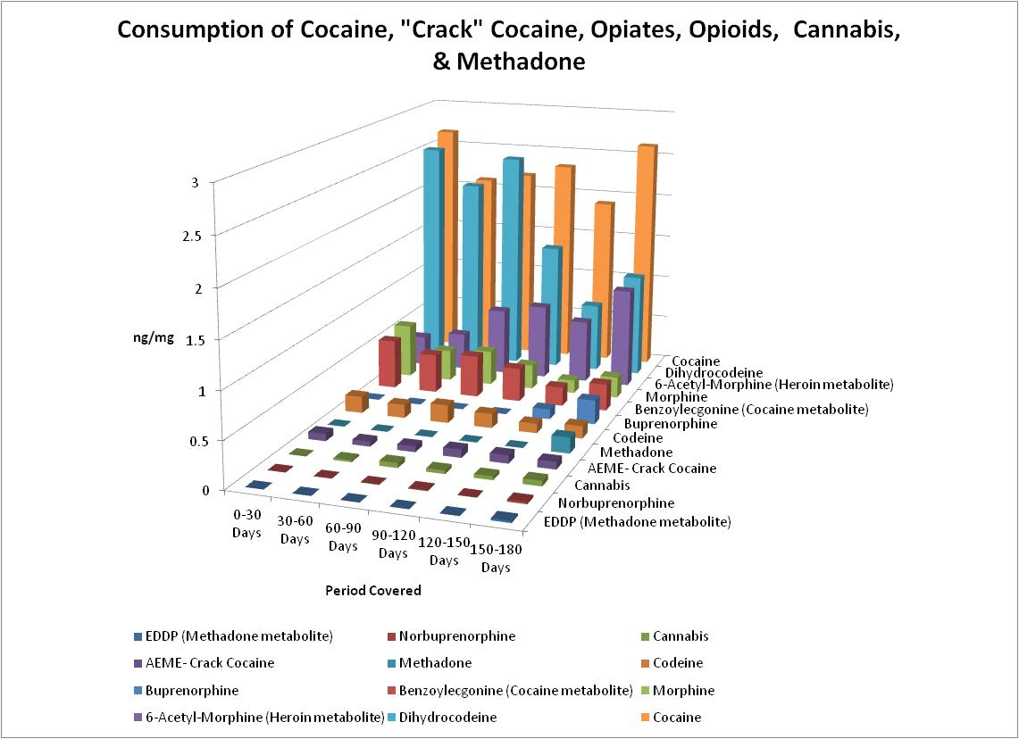

Slide 71
Bottom Line In Middle
Diverse Investigative Power
“Complementary” Tox = Good
Alcohol Bio-Markers = Another Tox Example to Drive You Nuts
Uncontrolled Factors = Forensic Reality

Slide 72
Old & Newer Alcohol Tests
  [ Breath & Blood for EtOH = 6 – 12 hours ]
  Urine for Ethanol = 8 - 24 hours
  Urine for EtG & EtS = 2 - 4 days

Slide 73
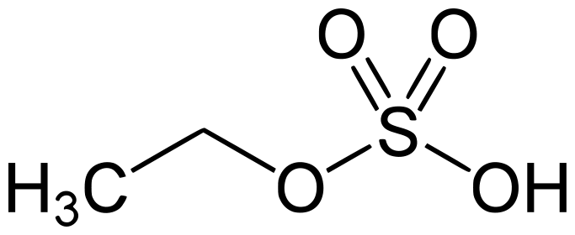
Old & Newer Alcohol Tests
  [ Breath & Blood for EtOH = 6 – 12 hours ]
  Urine for Ethanol = 8 - 24 hours
  Urine for EtG & EtS = 2 - 4 days
Ethyl

Slide 74
Alcohol Detection Windows
Hair Fatty Acid Ethyl Esters (FAEEs)
Hair Ethyl Glucuronide (EtG)
Urine EtG & EtS
S-B PEth
Serum-Blood CDT
Serum-Blood AST/ALT
Serum-Blood 5-HTOL
Month 6 Month 5 Month 4 Month 3 Month 2 Month 1 Week 2 Days 1-7 SC
Windows of Detection (WoDs in Days / Weeks / Months)

Slide 75
Forensic Hair Test Extensions
Hair alcohol bio-markers (FAEEs & EtG): unique & powerful “alternative” investigative consumption tools!

Slide 76
Categories of Alcohol Consumption
Classification according to amount of drinking
(not unequivocal; bio-diversity, plus depends on gender):
Strict abstinence 0 g/day
Non-drinker < 1 g/day
Moderate alcohol consumption 1-20 g/day
Medium “social” consumption 21-60 g/day
Risky alcohol consumption 61-120 g/day
Excessive alcohol consumption >120 g/day
Teetotaller
Social drinker
(1)
(2)
Alcohol Abuse
Alcohol Addiction
Diagnostic tasks
Measure maintenance of abstinence or control for “problem drinkers”
Discriminate between social drinking & alcohol abuse
Note: 60g EtOH = 7 - 8 beers / “shots” per day!
Notes:
Slide 2
It is one of the many possibilities to classify the population, to do this with respect to alcohol consumption. The group of strict teetotalers and non-drinkers is followed by moderate and social drinkers up to 20 and 60 g ethanol per day. Risky drinkers con­sume between 60 and 120 g per day and everything above 120 g/day is excessive consumption. From foren­sic point of view, there are two applications of alcohol markers: the con­trol of absolute abstinence of previous abusers, and the discrimina­tion between social drinking and alcohol abuse. My presentation will mainly deal with the second aspect.

Slide 77
Units/Grams Equivalent to Drinks
Units | Grams EtOH | Type/Amount of Drinks
1 | 8 | 1 drink (shot, 12oz. beer, glass of wine)
9.75 | 78 | 750 ml bottle of wine with 13% EtOH
19 | 152 | 475 ml (pint) of 80 proof (40%) Gin/Vodka
23.5 | 190 | 475 ml (pint) of 100 proof (50%) Whiskey
30 | 240 | 750 ml bottle of 80 proof (40%) Gin/Vodka
37.5 | 300 | 750 ml bottle of 100 proof (50%) Whiskey

Slide 78
Alcohol consumption bio-markers in hair
Fatty acid ethyl esters (FAEEs)
Group of more than
20 substances
4 esters selected
Concentration sum C_{FAEE}
used for diagnosis
C_{FAEE} range 0.1 – 145 ng/mg
depending on EtOH dose
Ethyl glucuronide (EtG)
C_{EtG} range 1 – 8000 pg/mg
depending on EtOH dose
Ethyl myristate
Ethyl palmitate
Ethyl stearate
Ethyl oleate
State of knowledge and practical use
Biochemical basics widely explored
Direct alcohol bio-markers
Discriminate between social and excessive drinking
Validated methods for analytical determinations
Established practical applications; still in test phase
Experiences with reliability and sources of errors
Notes:
Slide 3
Here are some characteristics of the state of knowledge of both markers. Fatty acid ethyl esters are a group of more than 20 compounds from which ethyl myristate, ethyl palmitate, ethyl oleate and ethyl stearate were selected for diagnosis. Depending on alcohol use, these four esters occur in hair in total concentrations between 0.1 and more than 30 ng/mg. Ethyl glucuronide is another minor metabolite of ethanol with hair concentrations between 1 and 8000 pg/mg, also depending on alcohol dose. Both FAEE and EtG are direct alcohol markers, discriminate between social and excessive drinking, can be determined with sufficient sensitivity and accuracy by vali­dated analytical methods and have been established meanwhile in practical applica­tion.

Slide 79
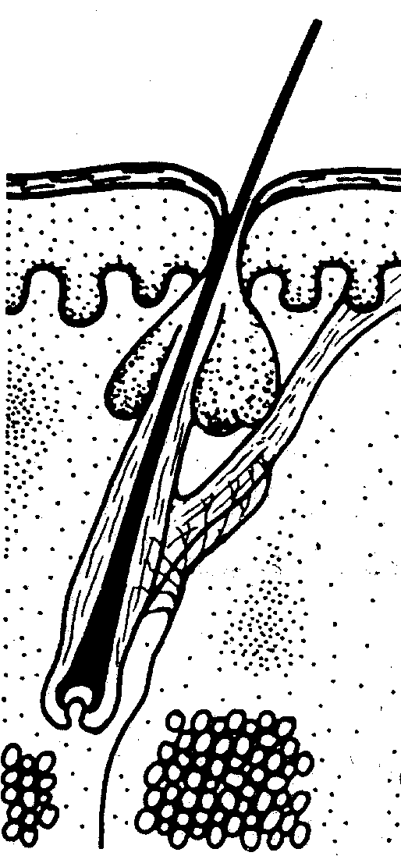
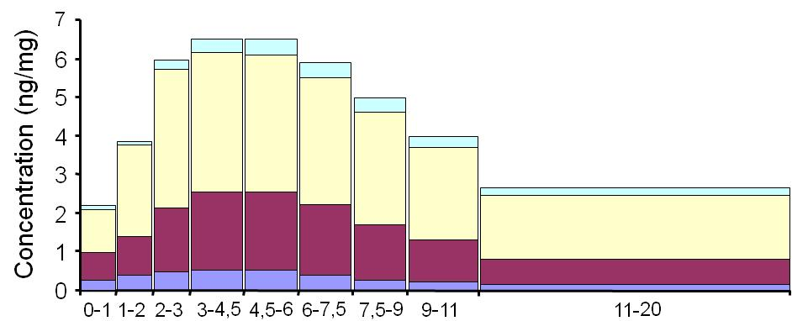
Incorporation
of FAEEs in hair
Incorporation is mainly from sebum
Detection in skin surface lipids by sweat patches, wipe test and
Sebutapes up to four weeks after abstinence begins
(Pragst et al. 2004, Nadulski et al. 2007)
High concentrations in n-heptane washings of hair
Delayed incorporation from surrounding fat tissues
Accumulation in the hair shaft outside of the root,
typical concentration profile of segments
Sebum
Dominating route
Formation from ethanol
in the sebum glands
and incorporation
in hair from sebum
Conc. in hair)
(ng/mg
Formation of FAEE
in the hair root
Incorporation of FAEE
from blood
Distance from hair root (cm)
Blood
vessels
Notes:
Slide 10
There is clear experimental evidence that FAEE are incorporated in hair from sebum. Ethanol diffuses into the sebum glands and is transformed there into FAEE by the efficient lipid metabolism of these holocrinic glands. From there the FAEE are excreted into the mouth of the hair root with a delay of 1 to two weeks, distribute over the whole hair length and diffuse from this sebum layer into the hair shaft. This mechanism leads to the typical distribution in hair segments which is found also after constant drinking: increase from proximal to distal by steady accumulation into the finished hair shaft

Slide 80
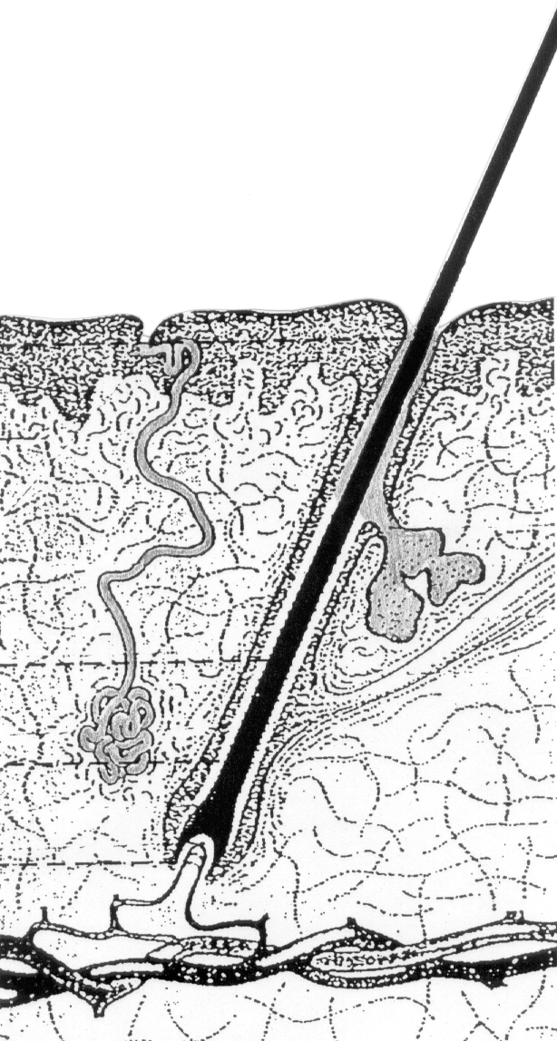
Incorporation of
EtG in hair
Mechanism still being researched:
Incorporation from blood
- low incorporation rate because of anionic
and hydrophilic structure
- Not totally improbable, since
concentrations in hair are very low
(b) Incorporation via sweat
- Preferred mechanism
- Excretion of EtG in sweat:
Schummer et al., Ther. Drug Monit 2008
⋅ Low excretion rate (acidic compound)
⋅ Concentrations two orders below
blood (1.7-35 ng/mL)
Complications
Variations in sweating depending on temperature, physical exercise &
individual bio-diversity
EtG in sweat
EtG in blood
Notes:
Slide 13
The mechanism of the incorporation of EtG in hair is not finally cleared. Incorporation from blood is believed to have a very low rate because of the anionic and hydrophilic structure. But it is not totally improbable, since the concentrations in blood are in the range of drugs and the con­centrations in hair are really very low. The preferred mechan­ism is the incorporation via sweat. According to Schummer et al., EtG as an acidic compound is also not very good excreted with sweat with concentrations in lower ng/mL range. Nevertheless, it can be postulated that the con­centration of EtG in hair is determined by the area under the EtG con­centration in blood vs. time curve. The main complications are variations in sweating depending on temperature, physical exercise and individual inclination to sweat.

Slide 81
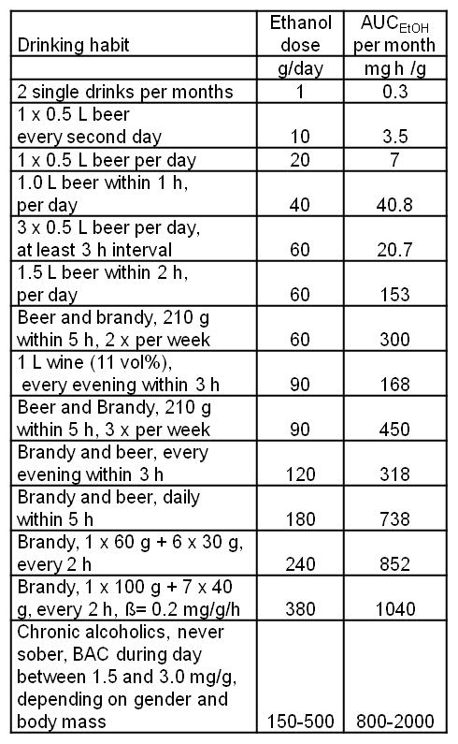
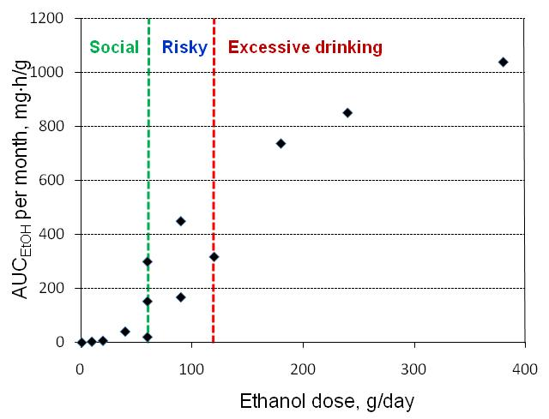
On monthly basis:
60
120
- Low AUC_{EtOH} for moderate and social drinking
- Strong increase of AUC_{EtOH} above 60 g per day
- Essential influence of drinking habits
Excellent basis for high discrimination power of the hair test for alcohol abuse
Notes:
Slide 17
In this slide, the AUC of ethanol were calculated for different drinking amounts and habits for one month. This corresponds approximately to the hair segment of 1 cm. It can be seen from the table as well as from the graphic plot that AUC remains low in the range of social drinking up to about 60 g/day and then strongly increases in the range of risky drinking to very high values. This is very good news for hair analysis. It shows that there is an excellent basis for a high discrimination power of the hair test on alcohol abuse.
But the examples shows also that drinking habits may add to a high degree to the uncertainty in the dose-hair concentration relationship.

Slide 82
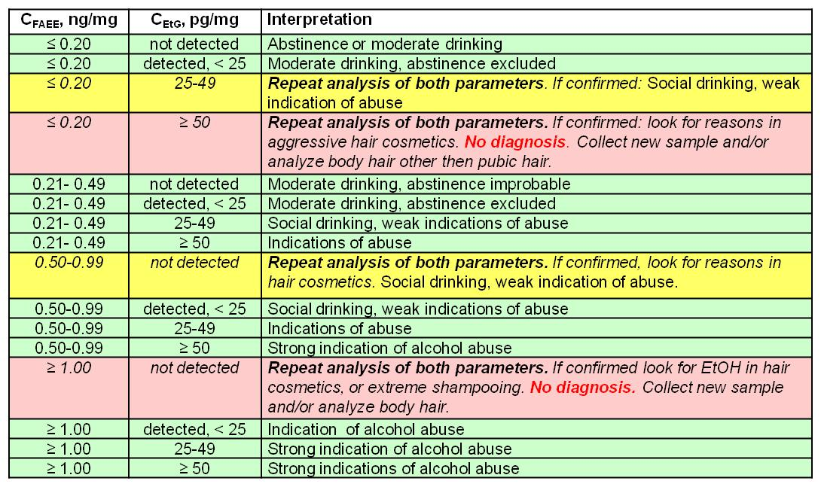
Scheme for combined interpretation of FAEE and EtG
Original 2009 cut-offs: FAEEs 0.5 ng/mg, EtG 25 pg/mg.
SoHT 2011 criteria: - Levels for Abstinence = FAEE ≤ 0.20 ng/mg, EtG not detected (<2.4-pg/mg) to 7-pg/mg
- Increased cut-off values (1.00 ng/mg and 50 pg/mg for SIX & THREE MONTHS!)
Notes:
Slide 23
I come back to the combined interpretation of FAEE and EtG. This scheme uses still our old cut-off values but could easily be adopted to the new conditions. Besides the cut-off’s also the levels of abstinence (≤ 0.20 ng/mg and “not detected”) and the double of the cut-off values (1.00 ng/mg and 50 pg/mg) were used as additional crite­ria. The green lines show sufficient agreement between both tests. Agreeing results confirm each other and increase in this way strongly the reliability of the diagnosis. Smaller differences were regarded to be in the range of bio­logical variability and interpreted in favor of a lower degree of alcohol consumption.
Yellow and red lines with larger differences require repetition of the determination of both parameters. In case of confirmation of both values an interpretation can still be given in the yellow lines, whereas for very strong deviations in the red lines no inter­pretation can be given and the collection of a new hair sample or of body hair is advised.

Slide 83
Pre-Analytical “Fun Factors”…
  Sample Provenance – Who, Why, When
    Who = Generally Adversarial
    Why = Custody, Visitation, Defendant
    When = Unannounced is Best
  Integrity – SC+Self-Report, Production
    SC+Self-Report = Competent Skeptic
    Production = Time is Money
  Stability – Pre-Analytical Degradation

Slide 84
Confounding “Forensic” Factors
  Lab Based: Availability of ID Standards
    “Bath Salts” & Cannabinomimetics
    Phosphatidyl Ethanol (PEth) Congeners
    Deuterated Analogues
  Interpretive Need: Comparable Result DBs
    Lack of “Abusive” Clinical Trials
    Environmental & Hygienic Impacts
    Self-Reports are NOT Trustworthy

Slide 85
Hair Treatment Categories
  Dye = Permanent (“grows out”) or Temporary (“washes out”)
  Colour = IBID. (but usually Temporary)
  Bleach = Peroxide-based (includes highlights and “brightening”)
  Hairspray = (typically un-named) daily “holding” spray products (EtOH Y/N?)

Slide 86
Bottom Line In Middle
Diverse Investigative Power
“Complementary” Tox = Good
Alcohol Bio-Markers = Another Tox Example to Drive You Nuts
Uncontrolled Factors = Forensic Reality

Slide 87
Future“Forensic” Realities
  Point of Collection (PoC) Testing
    “Point of Care” Equivalency (Lab)
    Investigative (PC) < PoE < RDSC < BaRD
    BAC from BrAC → DUID from Breath
    EtG and EtS in Oral Fluids
  PoC Complexities Increasing
    BioInformatics (DNA, Latents)
    PoC Apps for UDT, OFDT, HDT

Slide 88
Another Confounding Factor
  Availability of Identification Standards
    “Bath Salts” & Cannabinomimetics
    Phosphatidyl Ethanol (PEth) Congeners
    Deuterated Analogues
  Comparable Result Databases
    Lack of “Abusive” Clinical Trials
    Self-Reports are NOT Trustworthy
  Uncertainty = Legal or Scientific?

Slide 89
“Forensic Interface” Factors
  Gauging Precision – Evidentiary Limits
    Must Avoid Specimen Consumption
    Sample Heterogeneity (e.g. Hair, Stains)
  Peer Review – Multiple Deficiencies
    Evidence Collection – training, experience
    Documentation – manual vs. e- vs. “none”
    Expertise – CS vs. lab vs. legal precedence
    Lab Scope / Examiner Shortcomings
    NAS & No Publications

Slide 90
Bottom Line
Diverse Investigative Power
“Complementary” Tox = Good
Alcohol Bio-Markers = Another Tox Example to Drive You Nuts
Uncontrolled Factors = Forensic Reality

Slide 91
Acknowledgments
- URI Forensic Science Partnership
  - Tripler FTDTL, NMS, NYSDCJS, MSPCLS, NERFI, USACIL, AFDTL, EU/UK Drinkers, ADL
  - Forensic Practitioners*
  * Too Many to Name….

